Slide 1
SDLC
Software Development Lifecycle

Slide 2
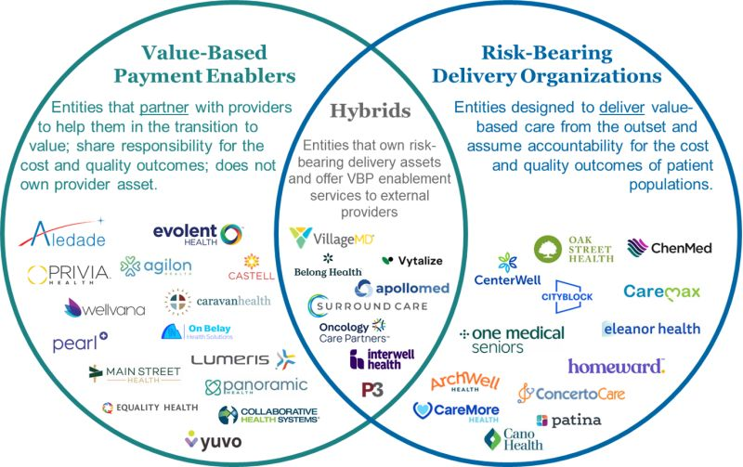
Interesting things…
https://www.linkedin.com/posts/katedelisle_this-graphic-helps-to-illustrate-the-types-activity-7156349533075992577-7Xuf?utm_source=share&utm_medium=member_ios

Slide 3

https://www.cnbc.com/2024/01/29/elon-musks-neuralink-implants-brain-tech-in-human-patient-for-the-first-time.html

Slide 4
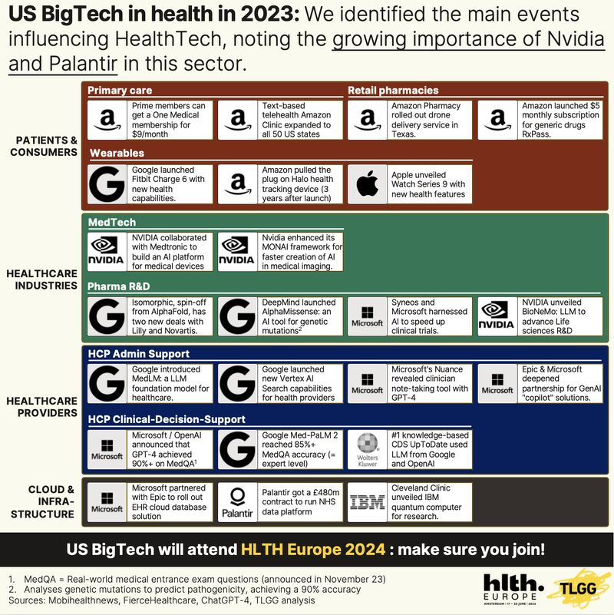

Slide 5
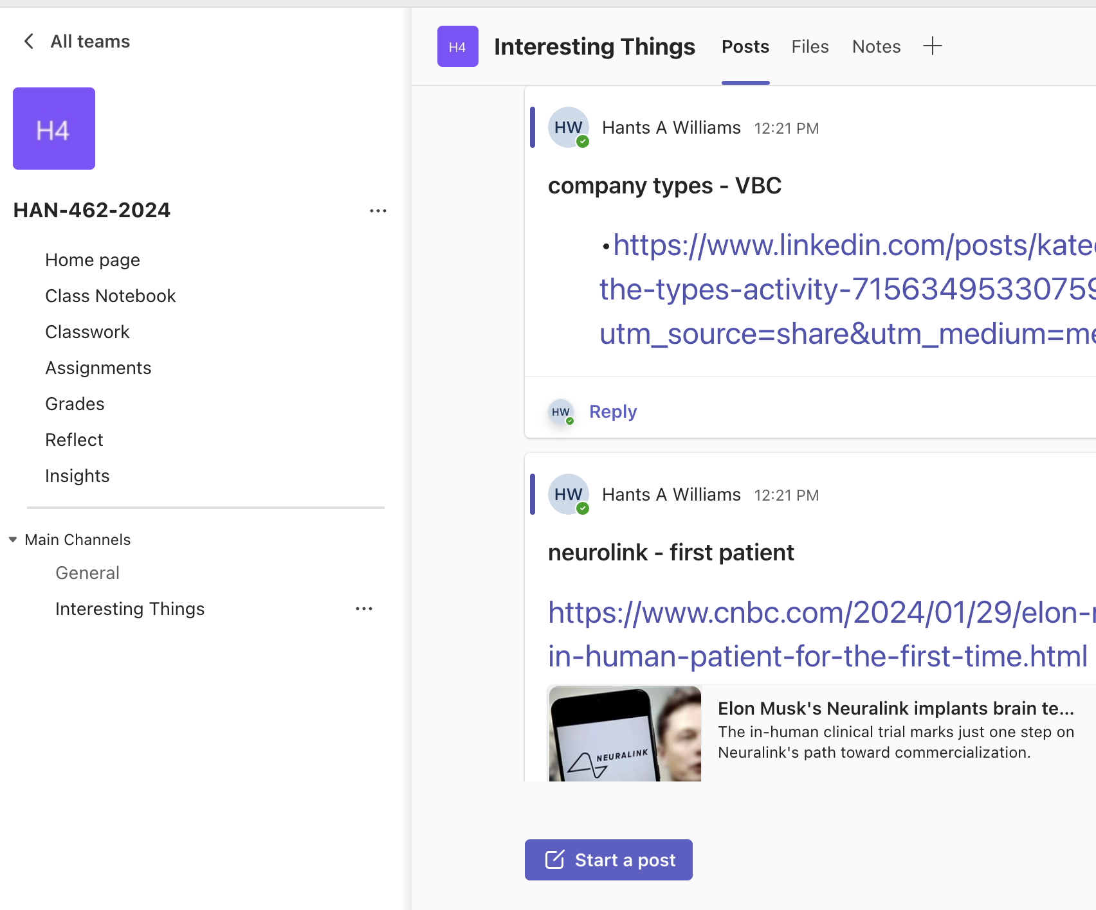

Slide 6
Review
Types of software (systems) we might create:
EMRs/EHRs
RIS / LIS
RCM
UM
PBMs
Analytical
Etc….

Slide 7
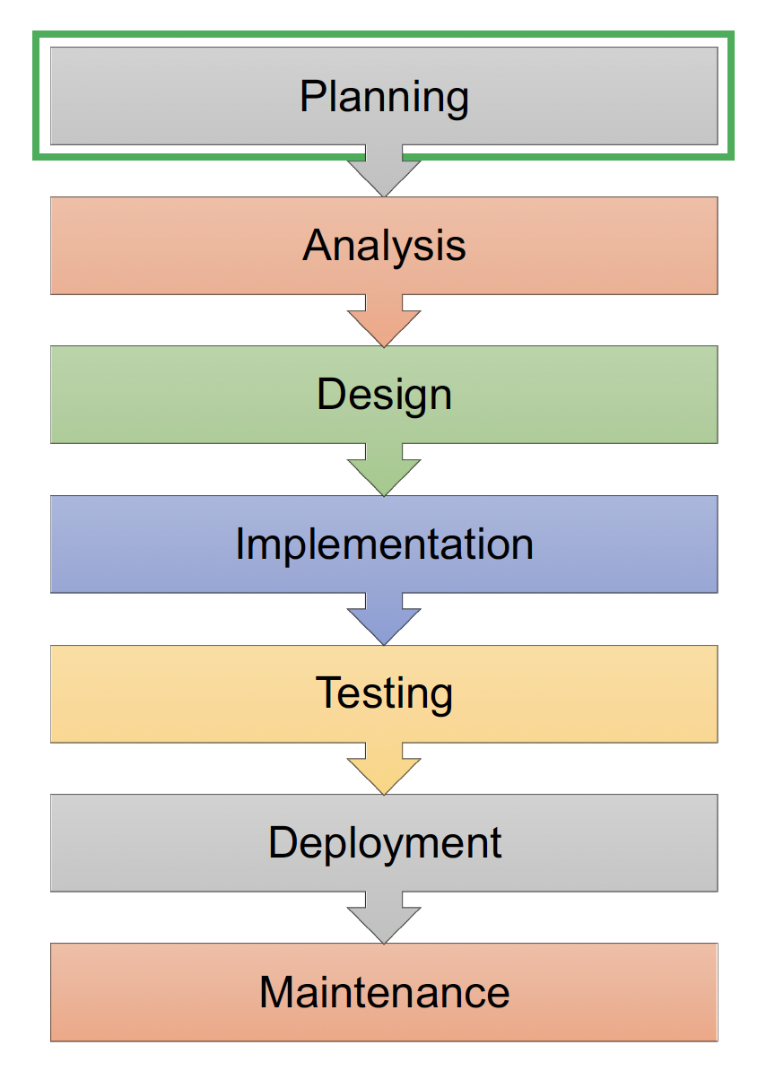
Planning
SDLC:
A conceptual model used in project management that describes the stages involved in an information system development project from the initial feasibility study through maintenance of the completed application
Launch
Maintain

Slide 8
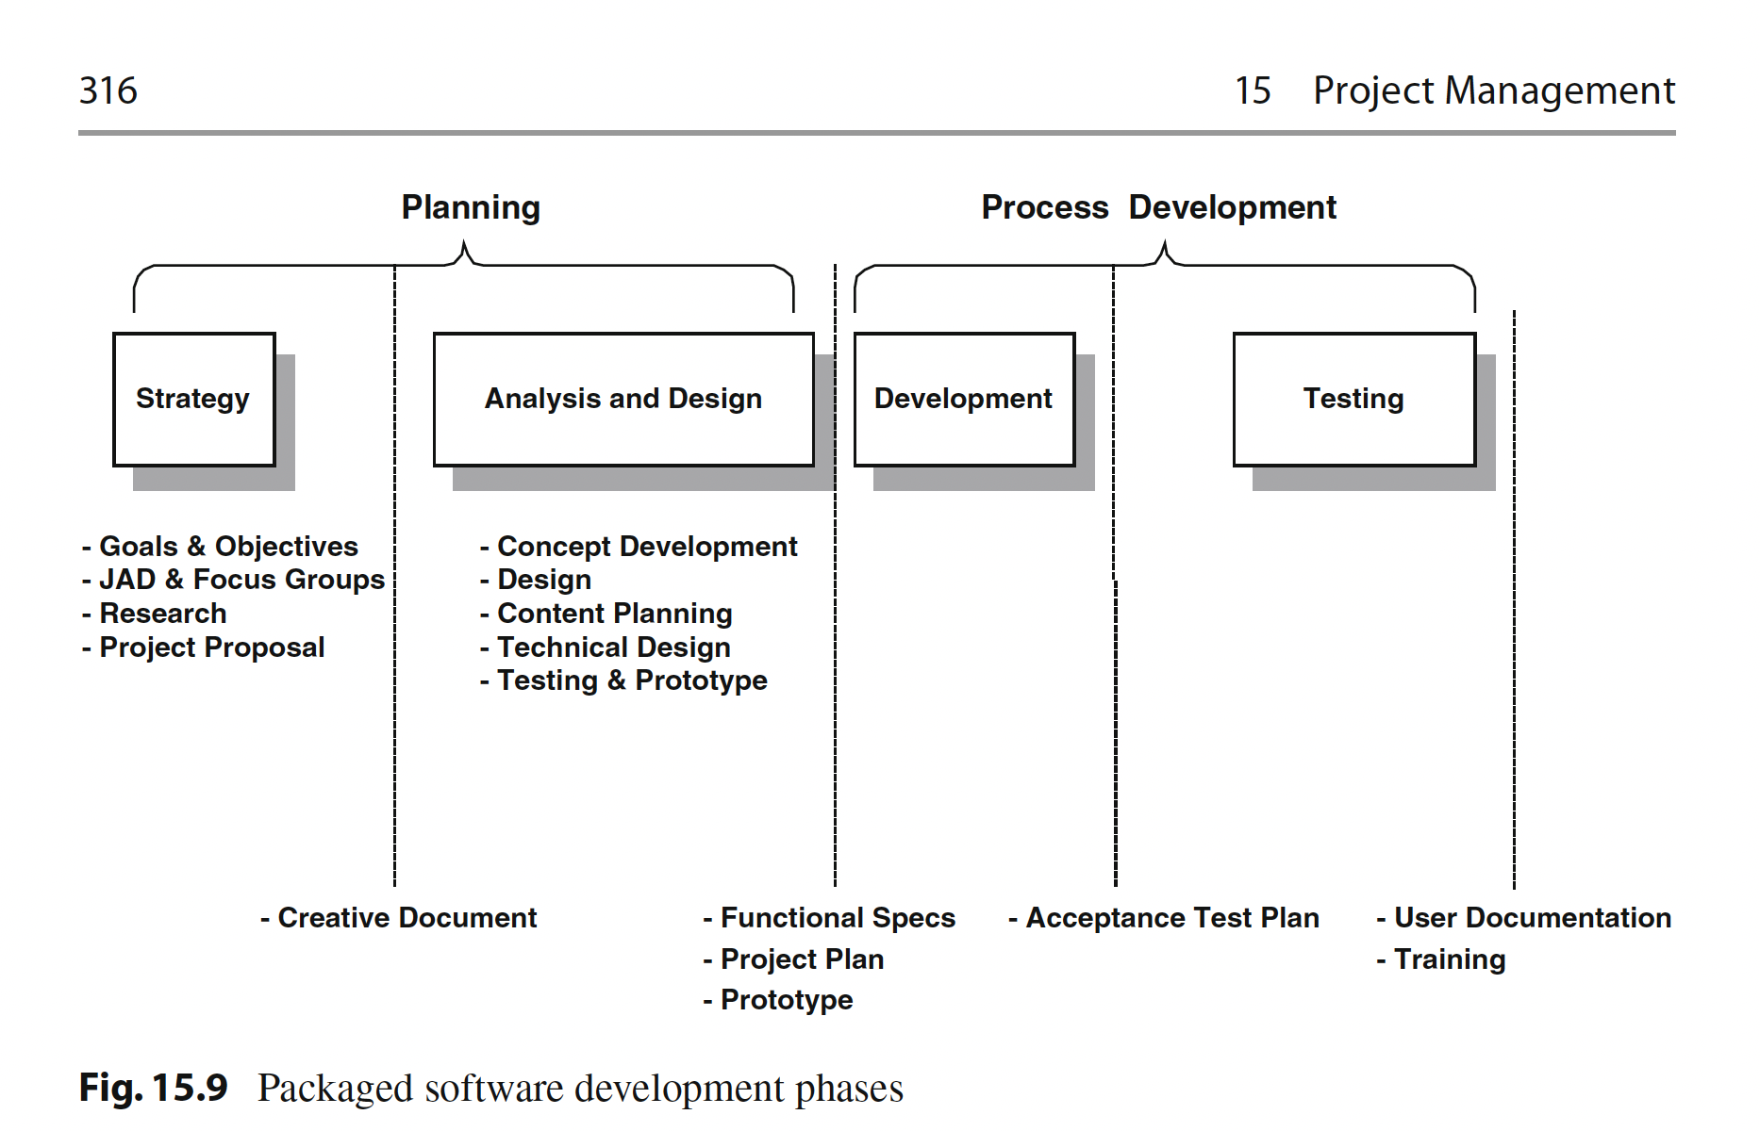
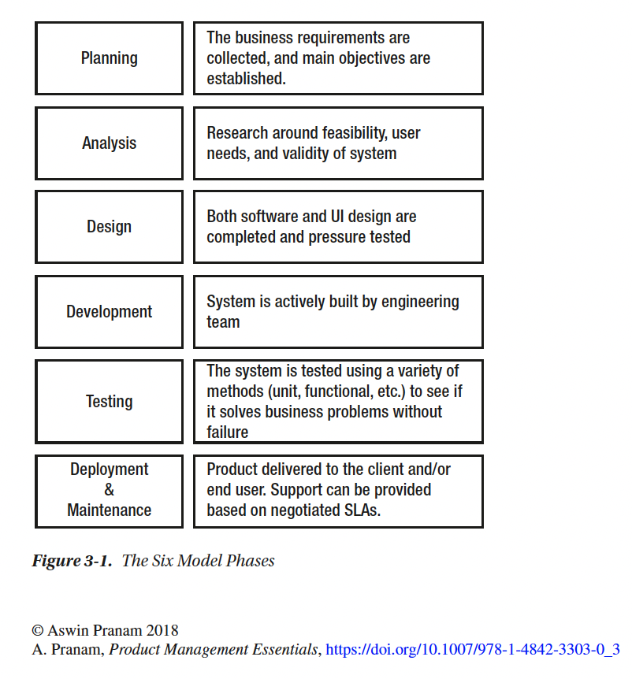

Slide 9
Phase 1: Planning

Slide 10
Phase 1: Planning Hierarchy and Taxonomy
Planning Hierarchy and Taxonomy
Organizational Strategic Plan
Strategic Information Systems Plan
Systems Development Lifecycle (SDLC)
There are numerous models for SDLC. Most contain these domains:
Needs Analysis
Systems Analysis (determines and defines what's needed in a system)
Systems Design (how the system is built/acquired and how it works/interoperates)
System Implementation (get it going)
Testing and Evaluation (does it perform as expected?)
Systems Operation (keep it running)

Slide 11
…Planning Phase
Is a statement of the IT Organization’s vision for how it will deploy technology to achieve its mission, goals, and objectives.
It helps to define the role of IT in the organization.
It aligns IT initiatives with the overall business’s Strategic Plan
It includes:
Overall current and future technology needs
Technical infrastructure and future priorities
Major direction and initiatives for the IT organization
3 to 5 year timeline
Estimates of capital and operating costs (optional)
And it uses Systems Analysis
Through executive interviews, SWOT exercises, trend analysis
To foster and imbue “systems thinking” into plan development:
How do initiatives align with organizational plan?
How do initiatives relate with each other?
What and where are the intersection, integration and synergy opportunities amongst initiatives?

Slide 12
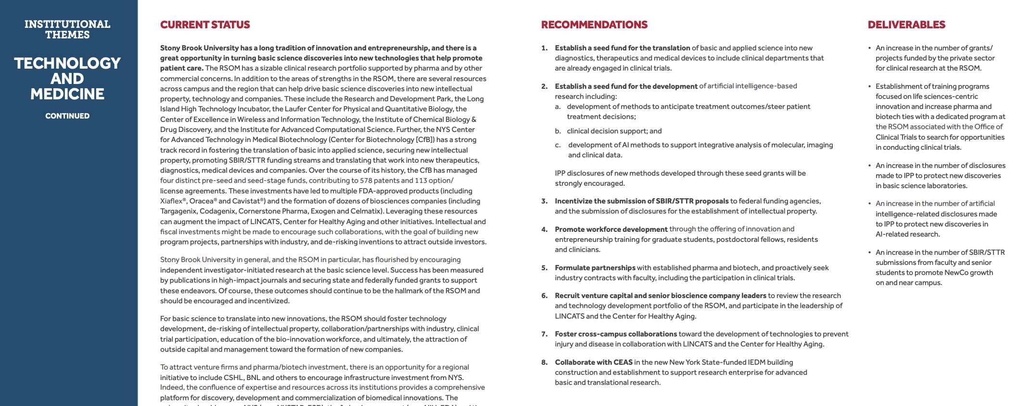
SBM Strategic Plan (School)
https://renaissance.stonybrookmedicine.edu/system/files/23080227H-5%20Year%20Strategic%20Plan%20RSOM%20Brochure_v2%5B35%5D.pdf

Slide 13
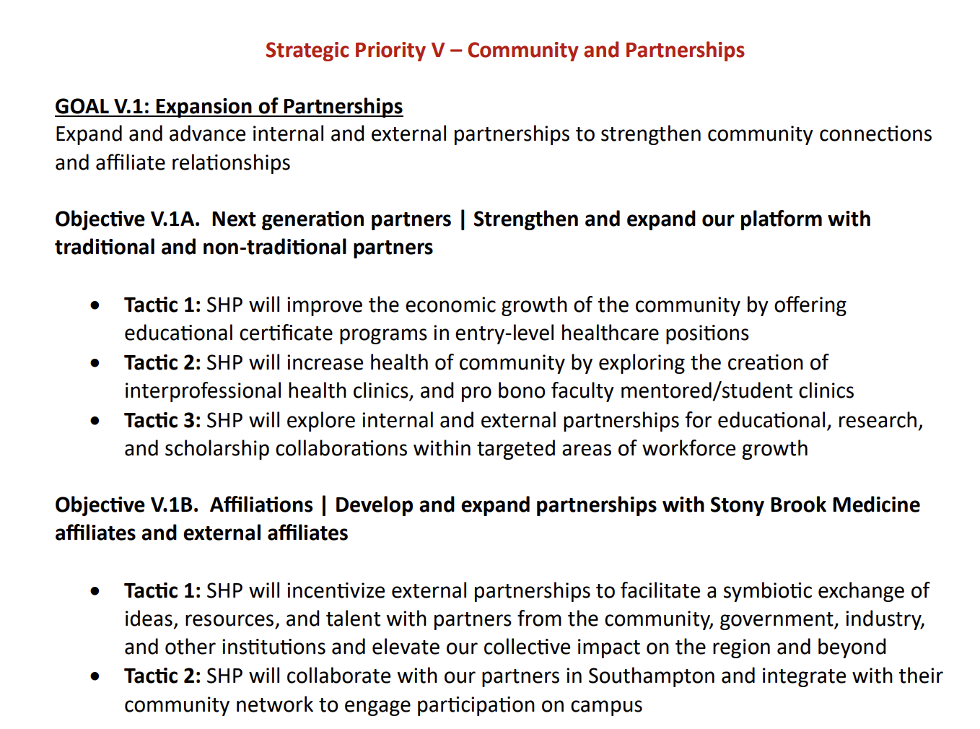
SHP Strategic Plan (School)
https://healthprofessions.stonybrookmedicine.edu/sites/default/files/School%20of%20Health%20Professions%20Strategic%20Plan_FINAL.pdf

Slide 14
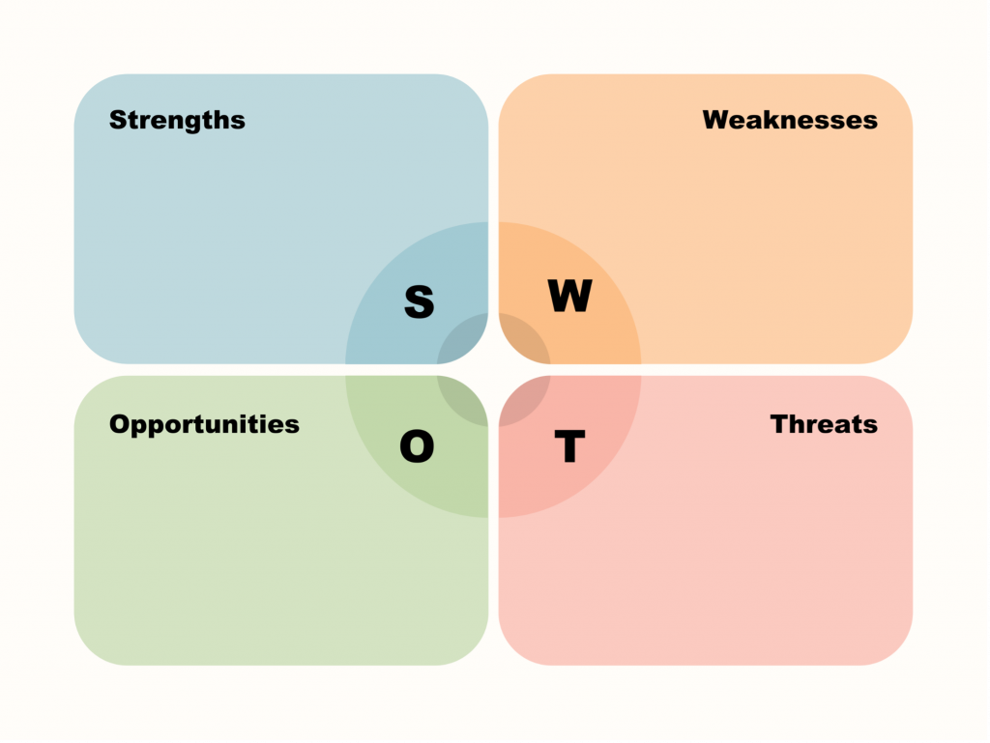

Slide 15
Phase 2: Analysis (PLANNING)

Slide 16
Phase 2: System Analyses
What is Systems Analysis?
A set of techniques and tools for understanding an organization’s operating environment in order to improve a process or outcome through the use of information technology.
Why is Systems Analysis important?
Information technology is widely viewed as a key enabler of improved care.
SA can improve the “fit” between the organization’s technology and care delivery effectiveness.
Rapid technology changes and increasing user sophistication tend to compress deployment and upgrade times so that the consequences of errors in selection, deployment and use of solutions are magnified.

Slide 17
Phase 2: Components of System Analysis
Components of Systems Analysis
1. Problem Analysis
Definition, Cause, Solution
2. Preliminary Investigation
Needs Assessment, Feasibility Analysis, Report of Findings
3. Requirements Analysis (non-technical)
Current State, Future State, Priorities, Stakeholder sign-off
4. Analysis of Alternatives
Alternatives, Cost-Benefit Analysis
5. Proposal/Approval
Proposal, Executive Presentation, Enthusiastic Endorsement
6. Project Management
PM Body of Knowledge, Initializing, Planning

Slide 18
1. Problem Analysis
First and most important part of Systems Analysis
Capture in a Problem Statement
Define the problem
Identify where the problem is occurring
Describe the size of the problem
Describe the impact of the problem on the organization
If complex, break into multiple parts
Identify the cause
Interviews
Monitoring tools
Flowcharting
Symptomatic vs root cause
Priority of fixing?
Unintended consequences

Slide 19
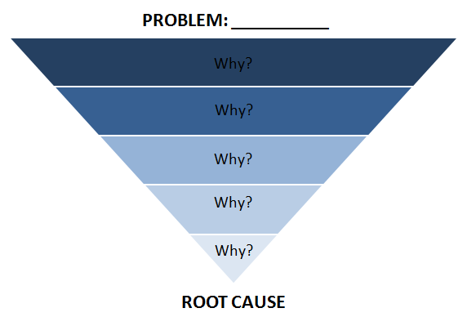
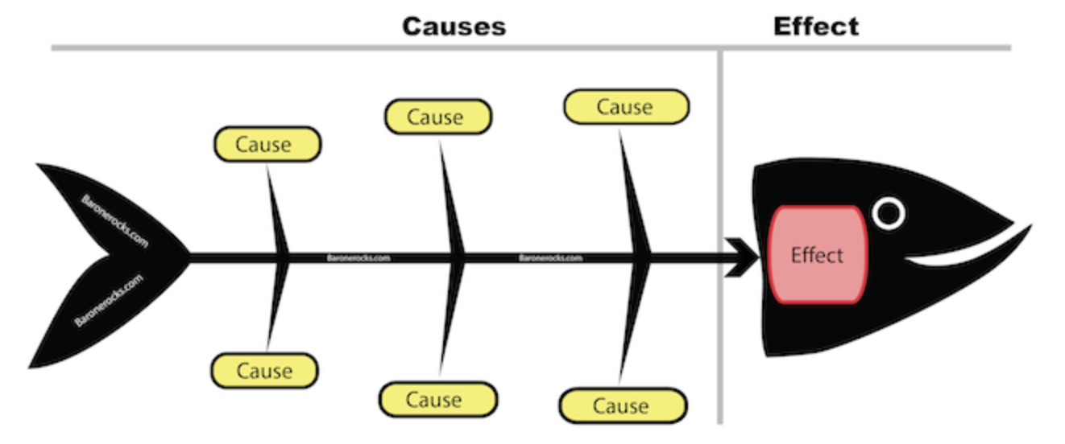
Fish Bone Diagram
the Five Whys tool
A cause and effect diagram, often called a “fishbone” diagram, can help in brainstorming to identify possible causes of a problem and in sorting ideas into useful categories.

Slide 20
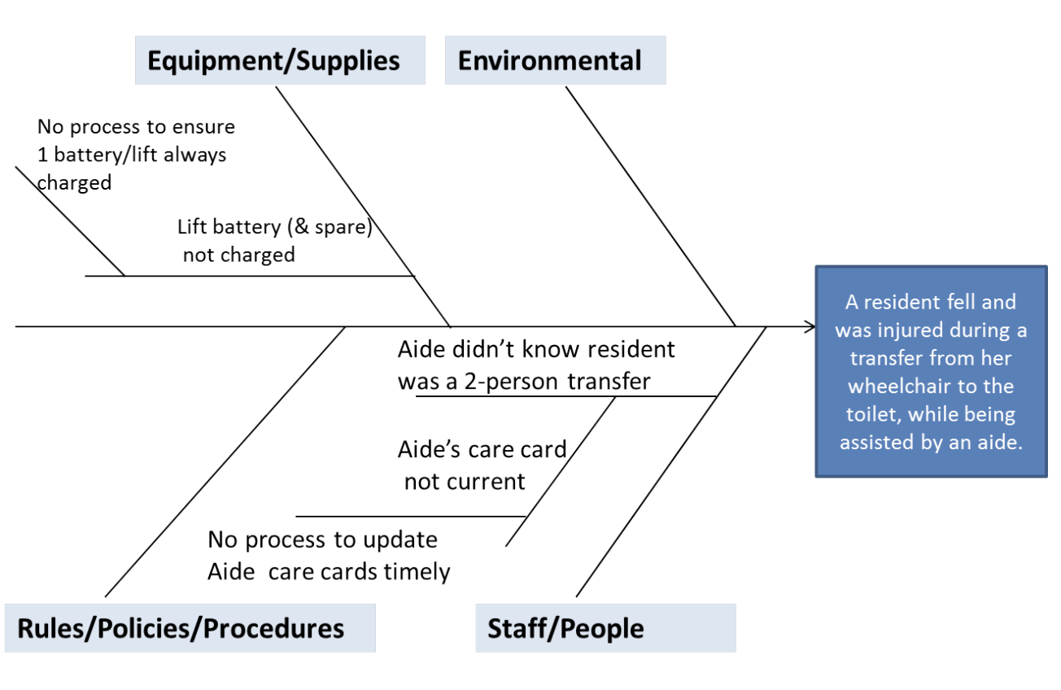
Fish Bone Diagram
A cause and effect diagram, often called a “fishbone” diagram, can help in brainstorming to identify possible causes of a problem and in sorting ideas into useful categories.
the Five Whys tool

Slide 21
2. Preliminary Investigation
DO NOT SOLUTION
A. Needs assessment
Proactive, unlike problem analysis which is often reactive
Avoids a ‘quick-fix’ mentality and looks at broader issues
Goal is to provide a recommendation on the scope and benefits of a solution
Information gained can later assist in requirements analysis and system selection, but these are not part of needs assessment.
Validates that the perceived needs are real
Should be vendor neutral
Sponsored by leadership
Conducted by analysts and subject matter experts
Objectivity, independence and competence critical for credible findings
Tools
Interviews with executive and department leadership, subject matter experts (internal and external), direct and indirect users, and other stakeholders.
Review of existing documentation
Observation
Surveys
Data analysis
Clinician involvement in major projects should include
Clinical executives –those holding executive or department chairs
Clinical leaders –peer leaders
Clinical practitioners –active practice and face day-to-day challenges of care delivery
Clinical knowledge keepers –academics and researchers
Clinical informaticists –understand IT and its importance for research, analysis and process improvement

Slide 22
Interviewing the client
Learning from anthropology/ethnographic interviewing best practices

Slide 23
Interviewing the client
Learning from anthropology/ethnographic interviewing best practices
Choose the right environment: The environment where the interview takes place is important, as it can influence the participant’s behavior and response. Choose a location that is comfortable and conducive to conversation. Do it in their house. Not yours. Get to know their environment (.
Create a semi-structured set of questions to guide the conversation. Avoid asking leading questions, and try to keep the questions open-ended to encourage a more in-depth conversation.
Establish a rapport: Before starting the interview, take a few minutes to build rapport with the participant. This can help them feel more relaxed and open during the conversation.
Respect their time: Be mindful of the participant’s time and make sure to keep the interview focused and on-topic.
Take thorough notes: Take thorough notes during the interview, including observations about the participant’s behavior and the environment.

Slide 24
Emic vs Etic
Both perspectives are important in ethnographic research as they complement each other to provide a comprehensive understanding of the culture/problem/phronema being studied.
Emic perspective refers to the point of view of the people within the culture being studied. It emphasizes the subjective experiences and perspectives of the participants and aims to understand the cultural concepts, beliefs, and practices as they are perceived by the members of the culture.
Etic perspective refers to the objective, external point of view of the researcher. It is based on scientific, theoretical and analytical frameworks and emphasizes the systematic and scientific analysis of cultural concepts and practices. The etic approach focuses on generalizing and comparing the cultural practices across different societies.

Slide 25
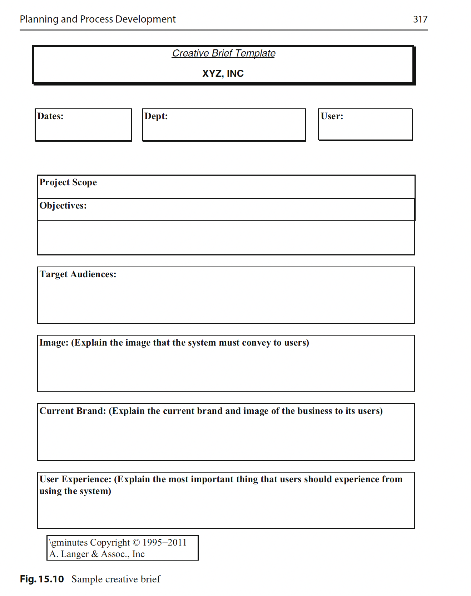
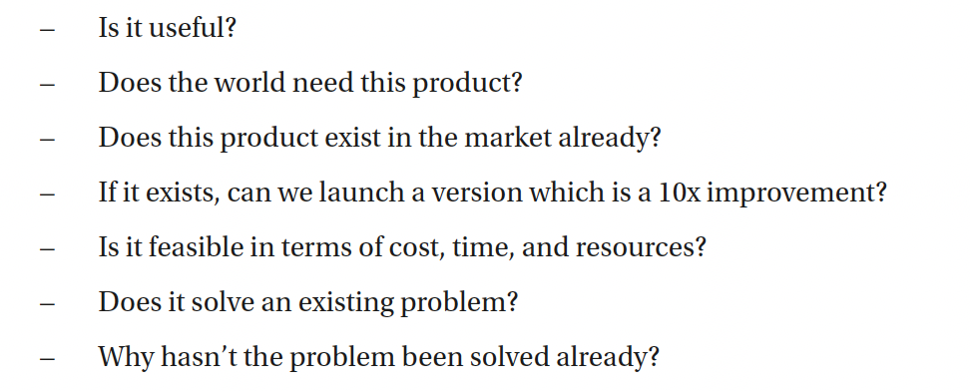
Requirements Gathering:
Creative brief

Slide 26
2. Preliminary Investigation
B. Feasibility assessment
Feasibility analysis or readiness assessment addresses the organizations ability to implement the solution
Identifies gaps that must be addressed before deployment/implementation
Covers such things as
Technical infrastructure
Application inventory
Ability to integrate with existing systems
Organizational readiness

Slide 27
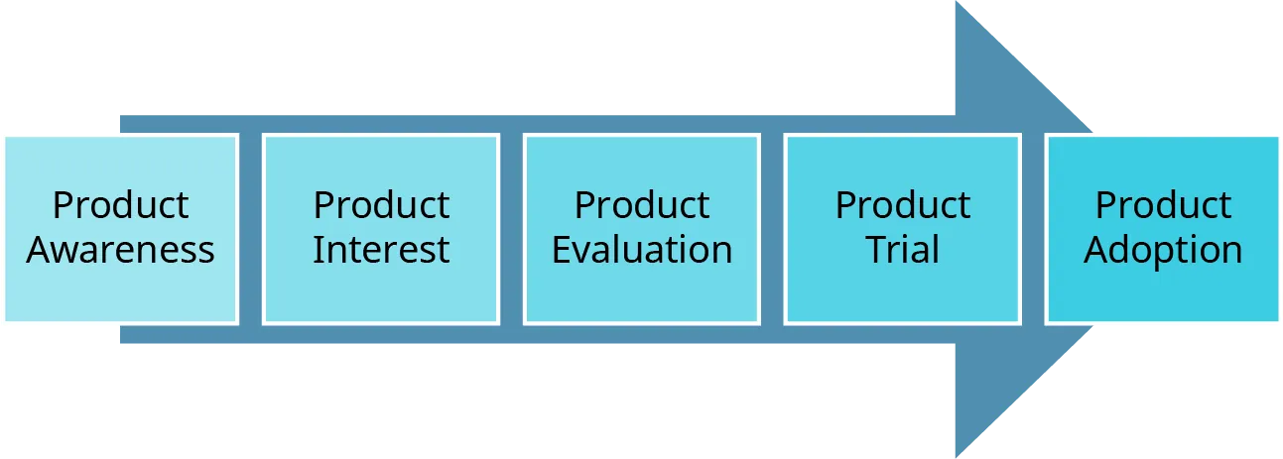
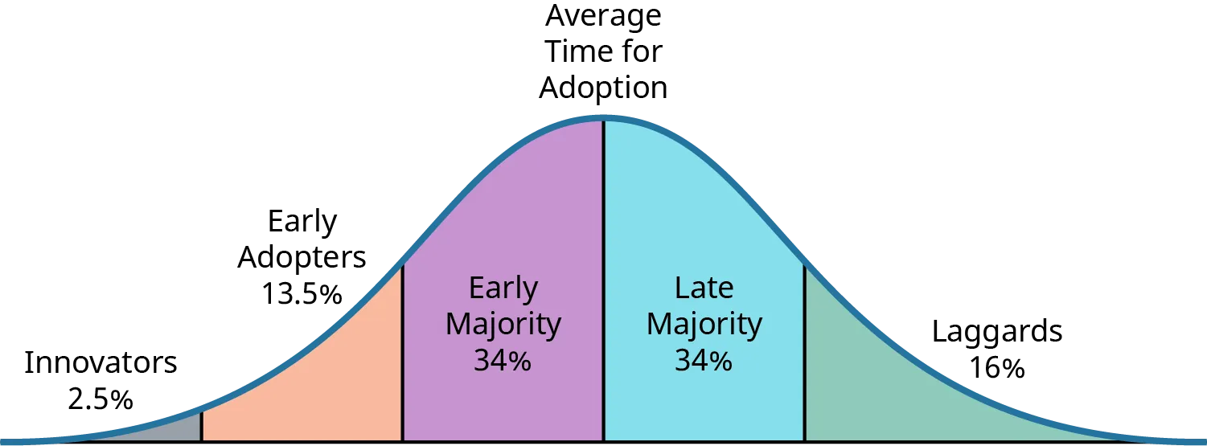

Slide 28
2. Preliminary Investigation
C. Output or deliverable is a “report of findings”
Articulates the objective, techniques used, participants, results, and recommended solution or approach.
Answers these questions:
What is the need or potential value to the organization of the solution
What is the scope of the solution
Is the solution feasible given the current technology and operating environment, and if not, what are the major gaps.

Slide 29
3. Requirements Analysis (non-tech)
More detailed description of what the system should do
Inputs, outputs, processing, performance and security
Greater detail than the needs assessment
Needs assessment focuses on “why”
Requirements analysis focuses on the “what”
Goal is to either
Describe the solution in sufficient detail to support the design and implementation or
To support the selection of a vendor product
Greatest risk in system development project is to miss or misinterpret a requirement
Provide objectivity in selecting vendor products
Requirements must not merely be “gathered” but “elicited” from the organization.
The successful analyst must truly understand the business overall and the needs of the users/stakeholders/organization

Slide 30
3. Requirement Analysis – Current State
Also called the “As Is” analysis
Identifies those fundamental business processes that the solution will need to support.
Describes how those processes are supported today along with current deficiencies
Importance of Current State analysis linked to span or scope of change brought on by new system.
Risk of current state analysis is that it can limit the thinking of participants to “inside the box”
Can mask differences between requirements and artifacts of current process.
Can introduce bias into the group.
Defend by limiting the time on current state analysis and focus on high level requirements.
Tools and techniques similar to those in needs assessment.
Interdisciplinary requirements workshops
Process charting
Activity diagram –describes the sequence of activities in a process and the logic controlling them.
Data flow diagram –indicates how data is input, stored, processed and output.
Flowchart –similar to activity diagrams and well suited for more complex processes.

Slide 31
3. Requirement Analysis – Future State
Identifies the requirements (the “what”) for new solutions
The deficiencies of the current state are creatively considered within the context of the initiative.
Challenge is to remain focused on the “what” and not the “how” (which is in the SDLC design phase)
Consideration of new processes associated w/ new solution
This is the time for process reengineering
Consider adopting best practices from other organizations
Focus on outcomes not tasks
Consider the problems identified in the current state analysis
Develop “use case” models and examples
Clearly articulate the integration of information across internal and external systems.
BY DESIGN:
Include privacy and security considerations (security by design)
Include diversity, minority – underserved/privileged groups (SDoH by design)

Slide 32
Once done with current and future <
Describe and Prioritize
Goal is to communicate to stakeholders how the solution will bridge the gap between the current state and the future state.
No standard format
Important to restate assumptions used regarding changes to processes that must occur to enable the solution
Should describe what are “needs” and what are “wants”
Sign-off is critical and includes not just a signature but a commitment to understanding and accepting the requirements as adequate to deliver the solutions anticipated benefits.
Sign-off reduces the chance of confusion over exactly what the requirements are and serves as a baseline for change requests.

Slide 33
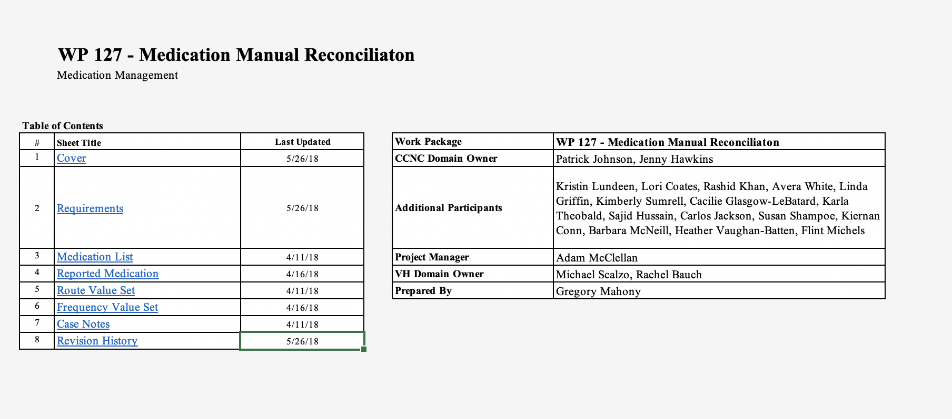
BRDs: Business Requirement Documents (or a PRD: Product Requirement Document)
CCNC

Slide 34
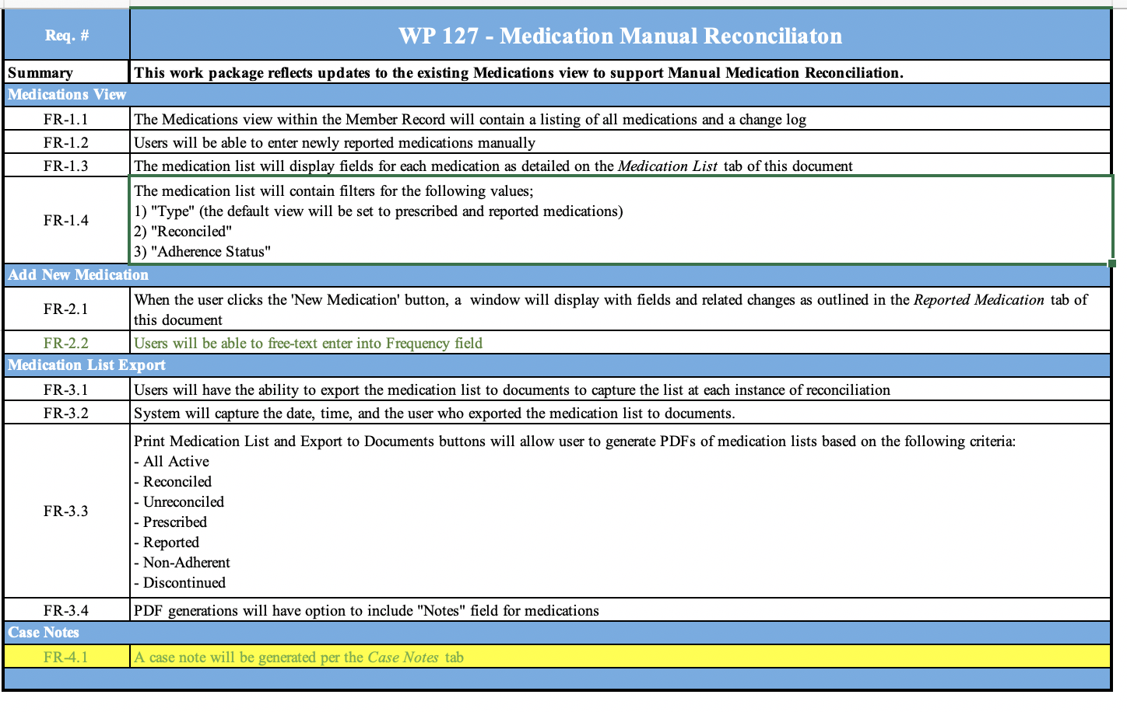

Slide 35
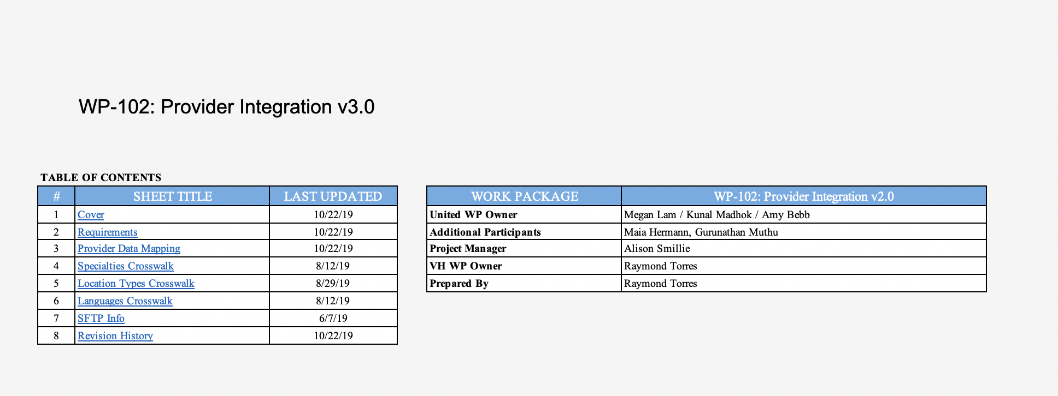
UHC_2019-10-25_WP-102_ Provider Integration_v3.0

Slide 36
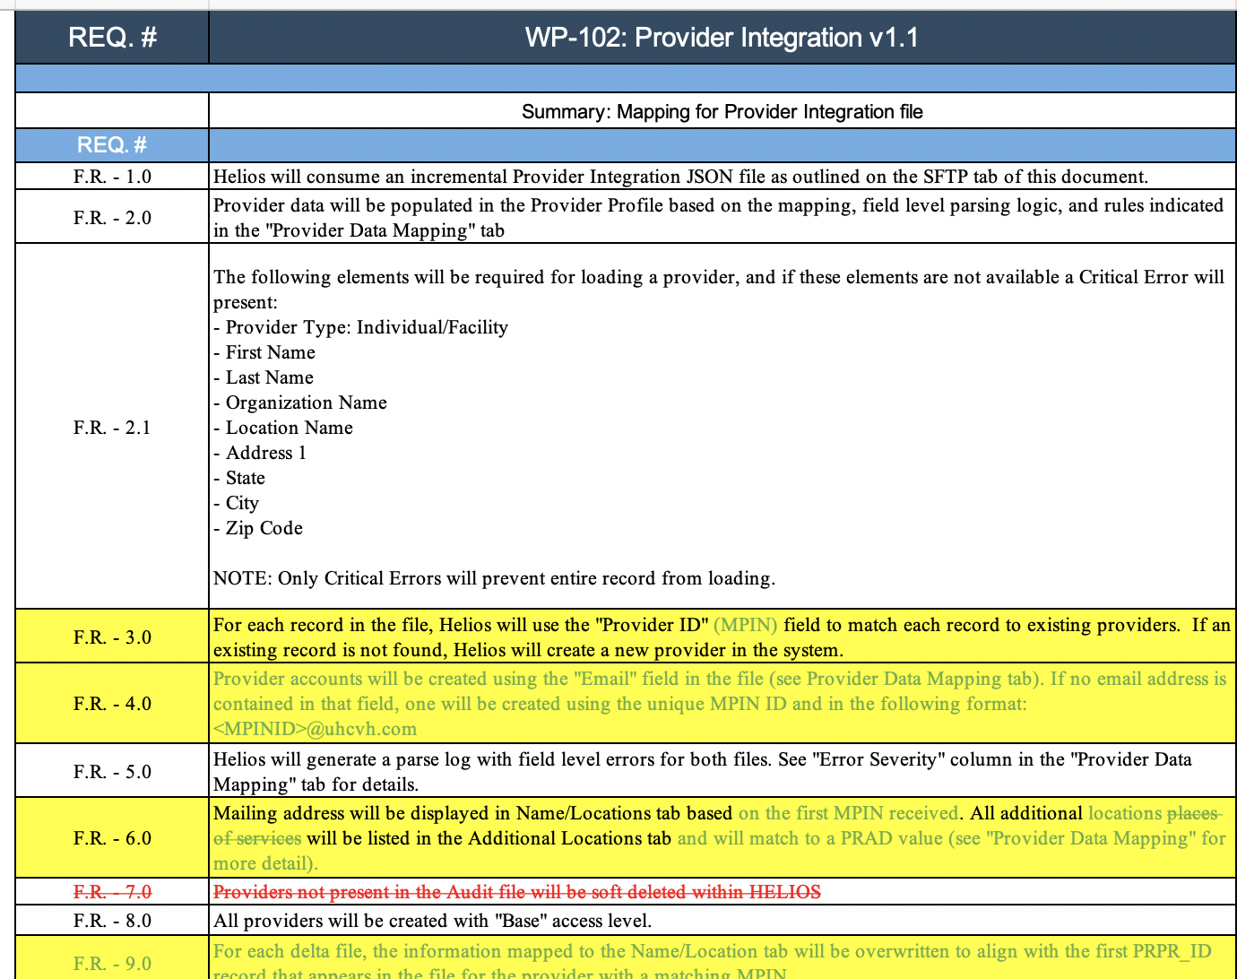
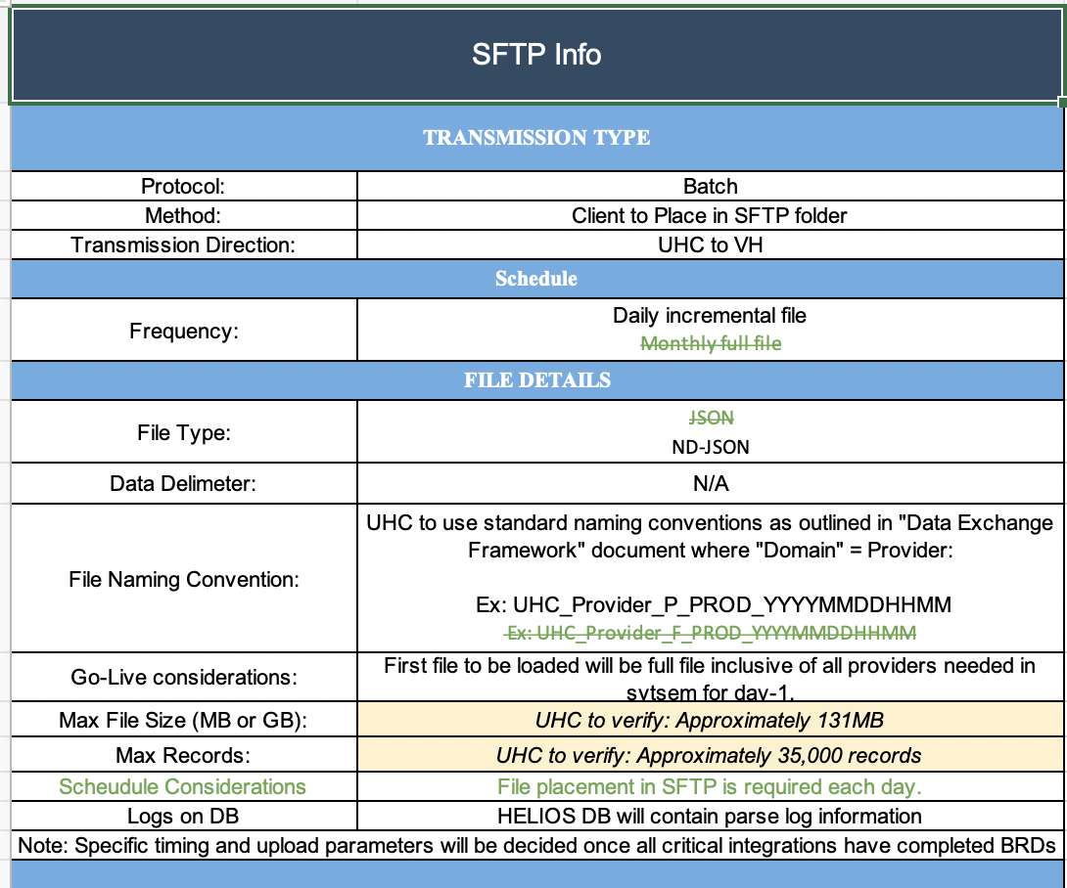

Slide 37
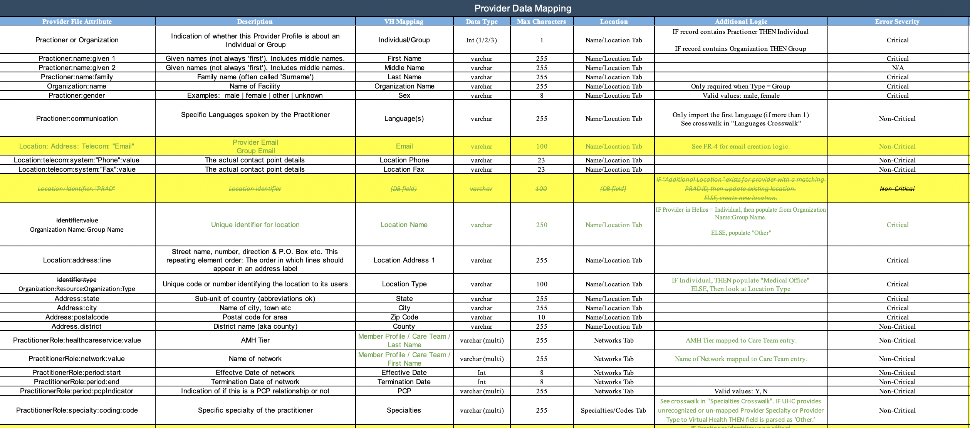

Slide 38
4. Alternatives / CBA
Most common alternatives considered:
Do nothing
Enhance the existing solution
Partially implement the proposed solution
Cost benefit analysis (CBA) often used for large initiatives
Validates the costs will yield benefits of equal or greater value than the costs
Provides a comparison of competing initiatives
Can be used to hold stakeholders accountable for realizing the benefits
CBA often a joint effort of project team, stakeholders and finance staff
CBA best after requirements are completed
CBA usually done over a 5 year period.

Slide 39
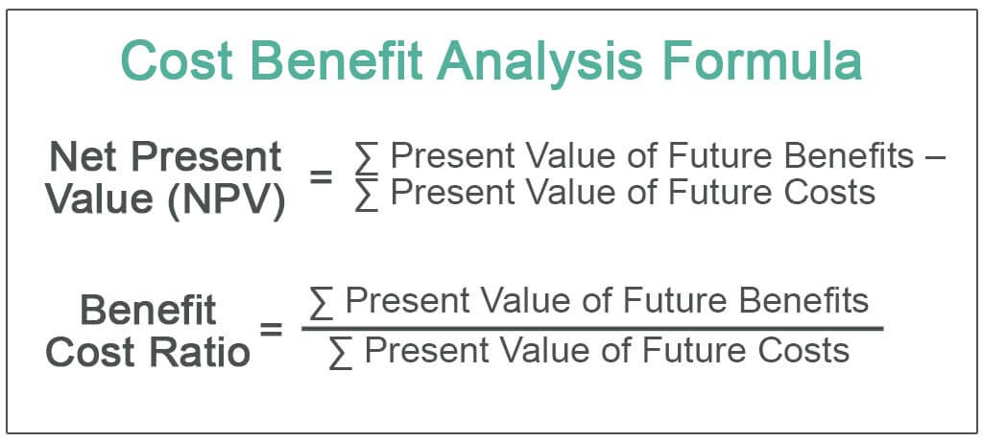

Slide 40
Cost Benefit Ratio
< 1: Loss
= 1: Neutral
> 1: Gains

Slide 41
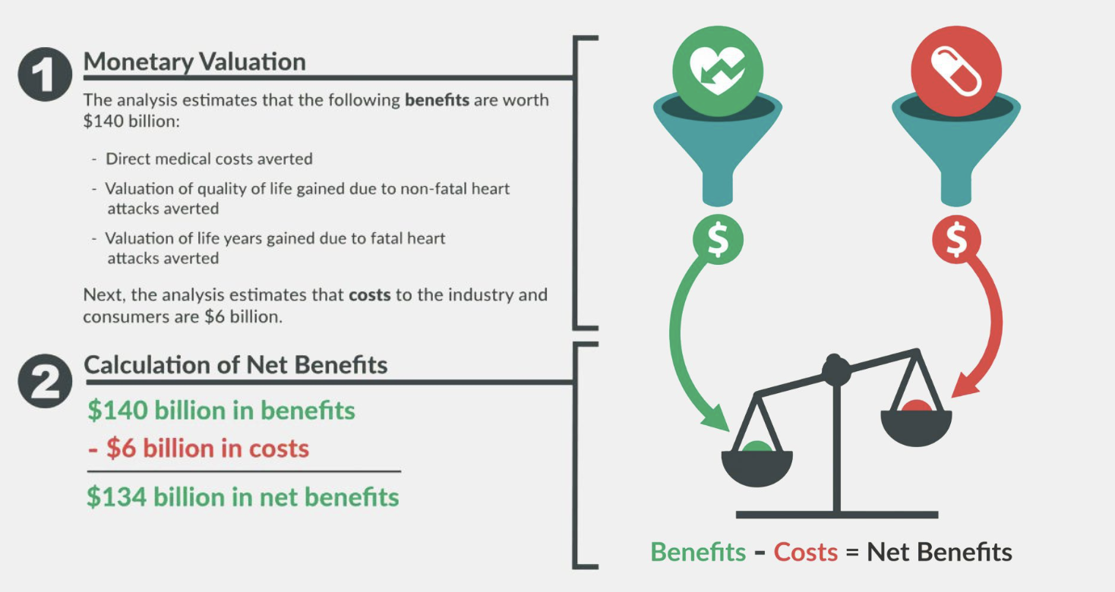
The example provides the results from a CBA of an intervention to reduce trans fats in the food supply.
RATIO:
140/6 = 23.3
https://www.cdc.gov/policy/polaris/economics/cost-benefit/index.html#:~:text=Cost%2DBenefit%20Analysis%20Example%3A&text=Valuation%20of%20quality%20of%20life,and%20consumers%20are%20%246%20billion.

Slide 42
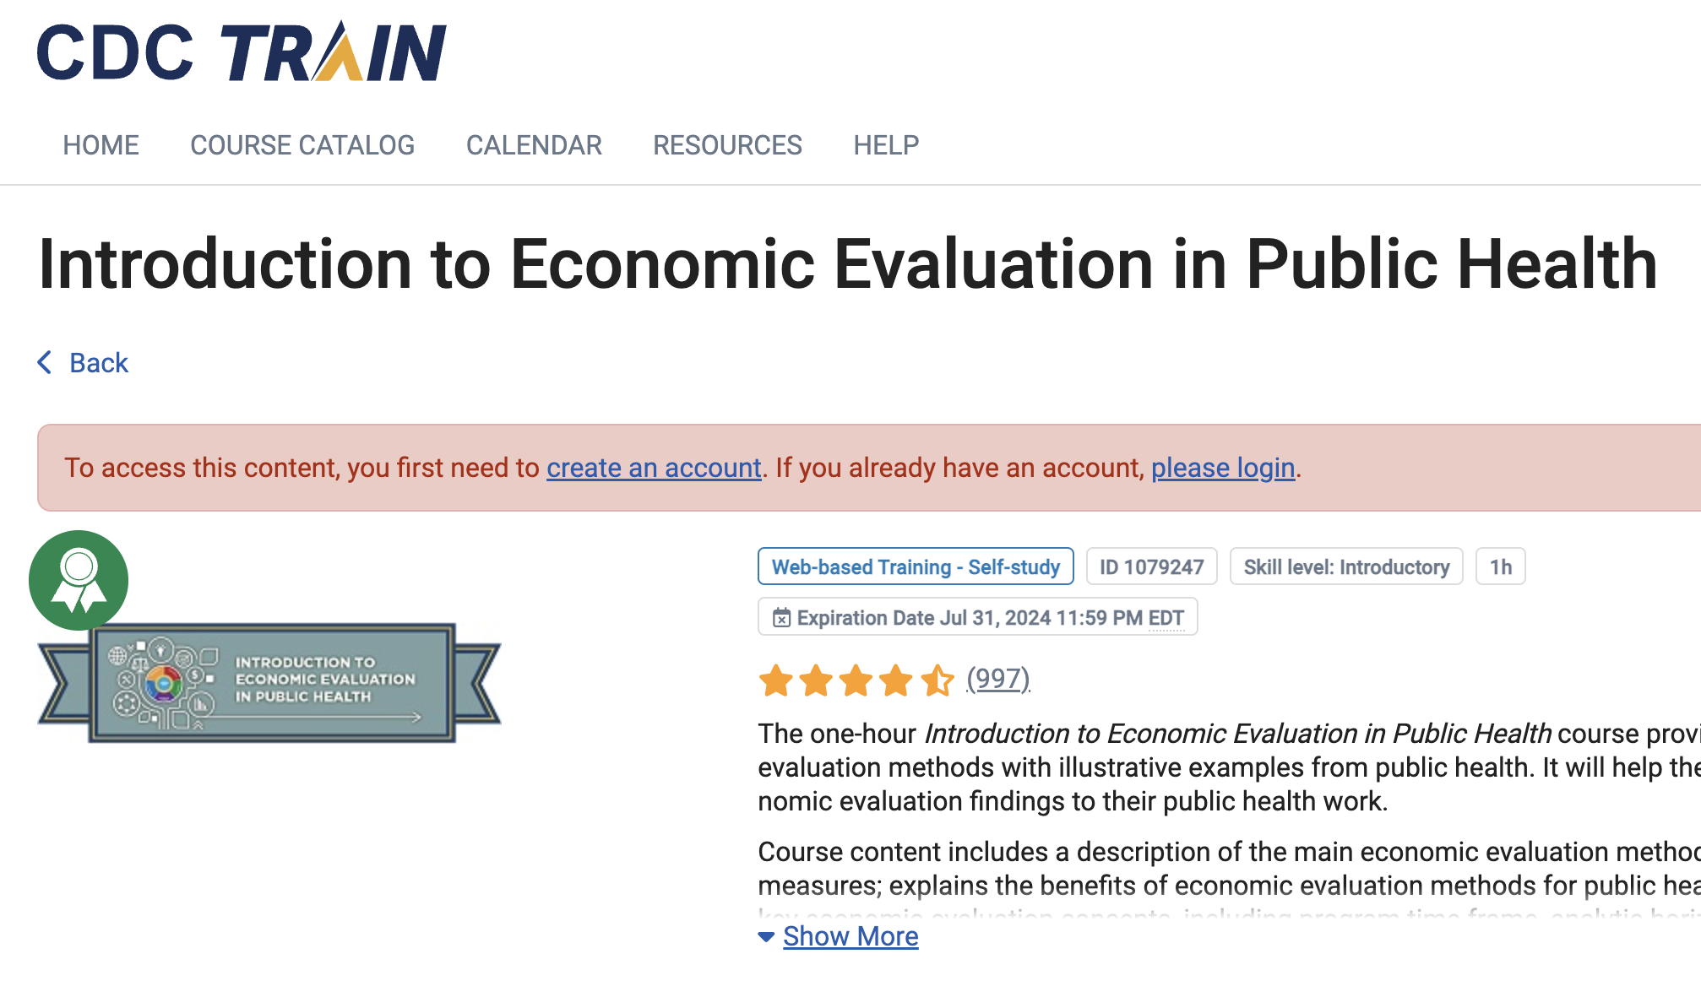
CDC tutorial to CBA: https://www.train.org/cdctrain/course/1079247/

Slide 43
5. Proposal / Commitment
Final step in Systems Analysis phase
At least two components:
A firm understanding of what the solution is and how it will impact the organization
Includes a formal specific and enthusiastic commitment to the proposed solution from the stakeholders and decision makers.
Commitment must be enthusiastic in order for the proposed solution to be successful
Initiatives that proceed with only tacit or no approval run enormous risks of failure
Includes
Executive summary
PowerPoint presentation summarizing the findings
Proposal in all its detail

Slide 44
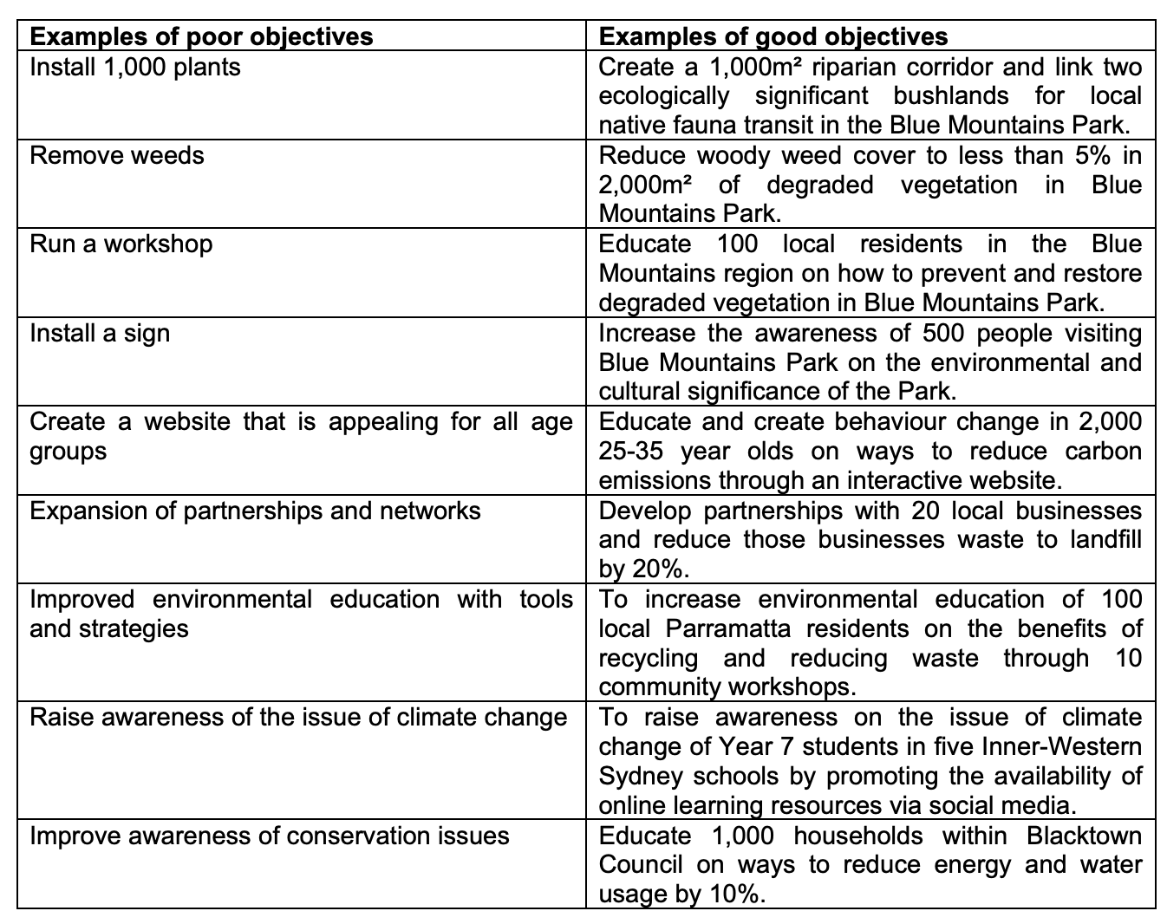
Success Metrics – Operationalize Success (KPIs)

Slide 45
What makes a good objective?
SMART
Specific: should be clear, well defined and unambiguous. Each objective should be focussed on one key outcome.
Measurable: should be measurable so that you can demonstrate it has been achieved. If an objective is not measurable, it is not possible to know whether you are on track and have achieved the objective at project completion.
Attainable: should be realistic and achievable. Agreement and commitment from relevant stakeholders is a must to ensure objectives can be reached.
Resourced: should be suitably resourced. Resources include access to individuals with relevant skills and knowledge as well as the necessary tools.
Time bound: should be achieved within a certain timeframe. This ensures commitment to a deadline so you know where you want to get to and by when.

Slide 46
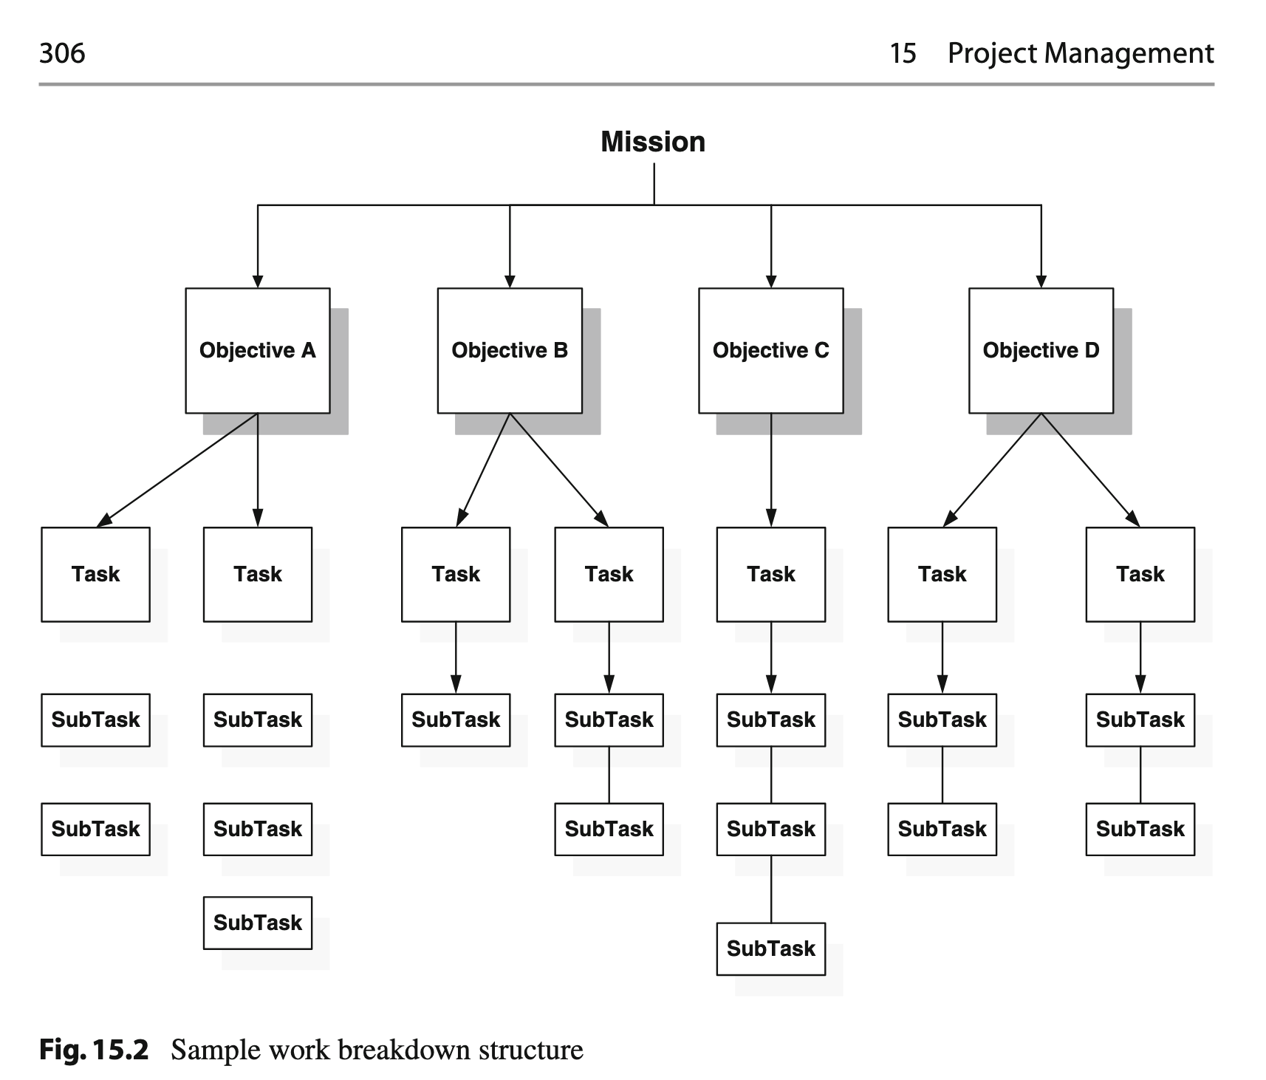
Work breakdown from objectives…

Slide 47
6. PM’s
Effective PM is a critical component of successful Healthcare IT initiatives
Purpose is to apply accepted practices to realize the project’s objectives
Recognized standard for PM is the Project Management Body of Knowledge (PMBOK) established by the Project Management Institute (PMI)
PMBOK is certified by the American National Standards Institute (ANSI/PMI 99-001-2008)
Many healthcare organizations have a Project Management Office (PMO) to manage their internal initiatives

Slide 48
6. PM’s
PMBOK defines generally accepted good practice in PM and defines the 5 stages of all projects:
1. Initiating: defines and authorizes the project scope
2. Planning: refines the objectives and plans the activities, resources an schedule
3. Executing: performs the activities of implementing the project
4. Monitoring/controlling: determines of the project is keeping on schedule and budget and determines corrective action
5. Closing: terminates the project and ensures hand-offs are make

Slide 49
GANNT charts
Seeing it all
Henry Gantt in the 1910s as a visual tool to help track the progress of a project.
Help project managers to understand the tasks involved in a project, the duration of each task, and the dependencies between tasks.
Provides a clear overview of the project timeline, making it easier to identify any delays or roadblocks that may arise
Are very useful in complex projects with multiple tasks and dependencies, as they provide a visual representation of the entire project, making it easier to communicate with stakeholders and keep everyone on the same page

Slide 50
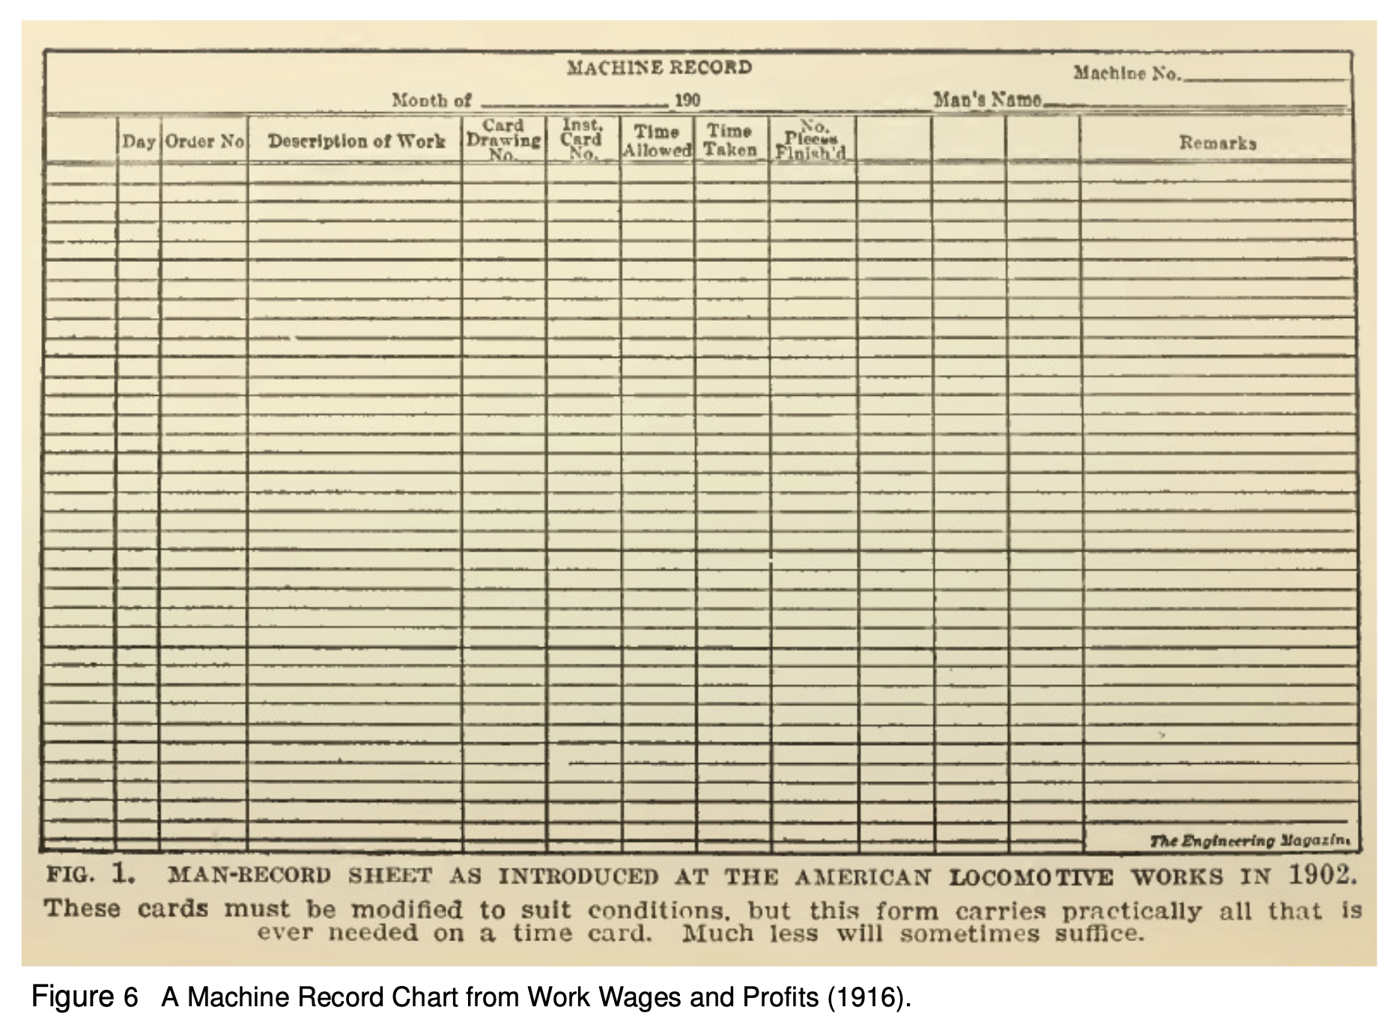
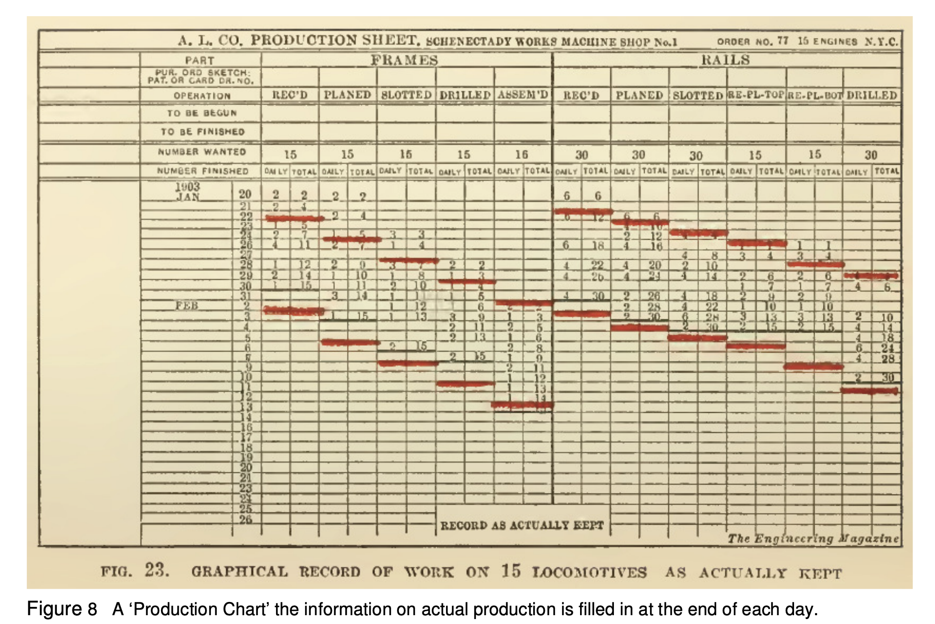
https://www.mosaicprojects.com.au/PDF_Papers/P158_Henry_L_Gantt.pdf

Slide 52
The example below shows some basic steps in EHR selection mapped for a period of time.

Slide 53
https://templates.office.com/en-us/simple-gantt-chart-tm16400962
https://www.microsoft365.com/launch/Excel?ms.url=templates.Excel.new&templateId=TM16400962&omkt=en-us

Slide 54
Phase 3: Design (PLANNING)

Slide 55
Phase 3: Design:
Process of defining the architecture, components, modules, interfaces, and data for a system to satisfy specified user requirements

Slide 56
Design: Goals
Create accurate technical specifications
Choose between “build-or-buy” development approaches
Insure the design supports the business needs
Minimize compatibility and compliance issues
Develop the RFI/RFP
Identify dependent sub-systems
Ensure user acceptance

Slide 57
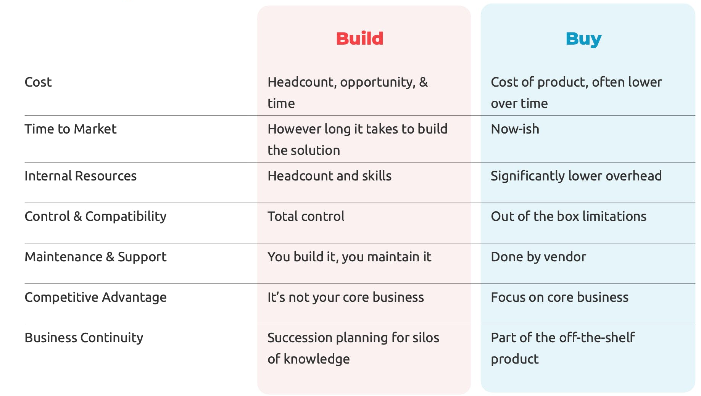

Slide 58
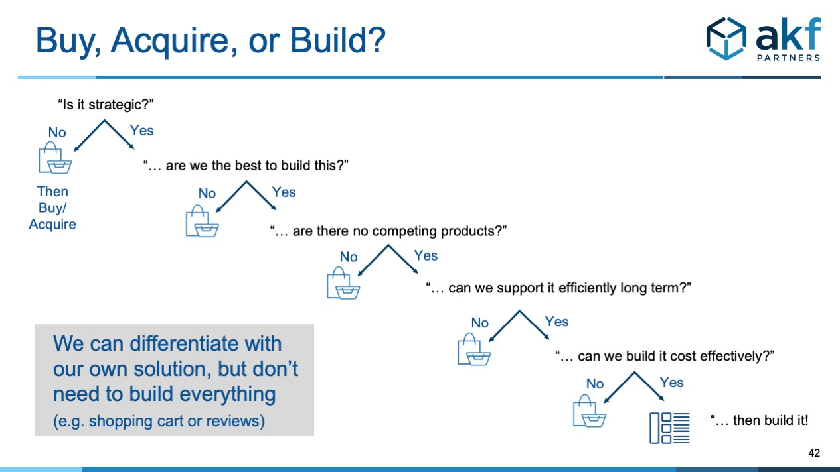

Slide 59
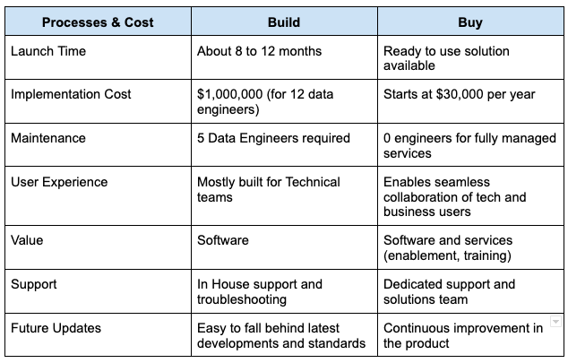
Example: Data Catalog: buy or build?

Slide 60
Components
Component relevant to HIS today:
Design selection
Technological specifications
Systems compatibility
Security Compliance
Business Continuity
Interoperability

Slide 61
Design
Design the system
Output specifications
Input specifications
Data specifications
Code and programming specifications
Flow diagrams and Use Cases
Development Cost/Benefit analysis
Preliminary design review
Design user support and training
Conversion and migration strategies
Security risk assessment and mitigation
Critical design review and sign-off
Present deliverables for management approval
LOTS OF DIVERSE KNOWLEDGE REQUIRED

Slide 62
Design Team: Interdisciplinary
Team Leader –domain expertise, IS experience, organizational maturity
Systems Analysts
End-users
RFP Committee
Developers
Trainers
Legal
Purchasing
Project Management Office
Domain Experts and Consultants

Slide 63
Design Deliverables:
Technical specifications document
Translates functional specs to technical specs. Go into RFI or RFP.
Systems design document
Primarily used in internal development projects.
Contains the input/output and data specifications
Should include a cost/benefit analysis
If “buy” vs “build” the vendor’s design document should be reviewed by the organization
Security risk document –assessment results
Network hardening, intrusion detection, DR, vulnerability analysis
Conversion and integration plan –compatibility findings
System interface description should be included if there is data exchange w/ other systems
Training plan –initial and ongoing
Prototypes and mock-ups –useful when building systems.

Slide 64
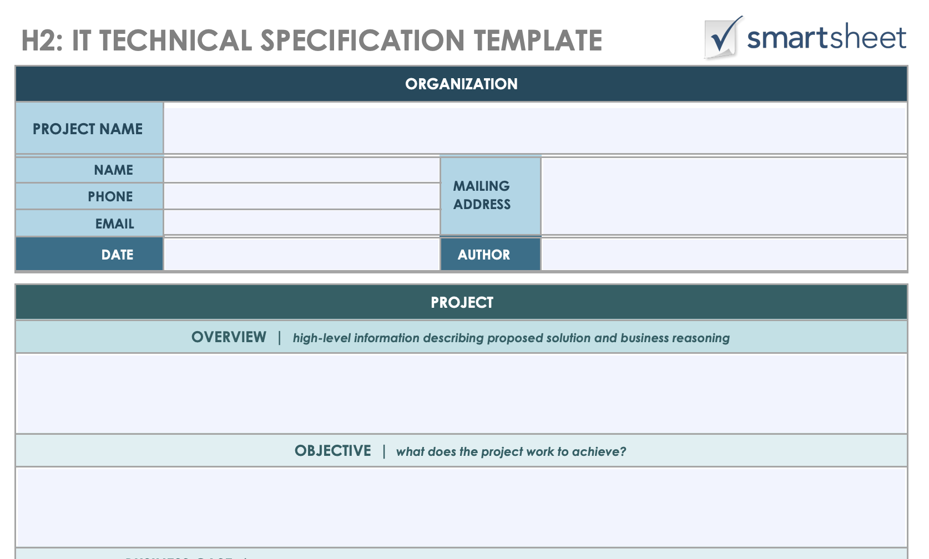
https://www.smartsheet.com/sites/default/files/IC-IT-Technical-Specification-Template-PDF.pdf

Slide 65
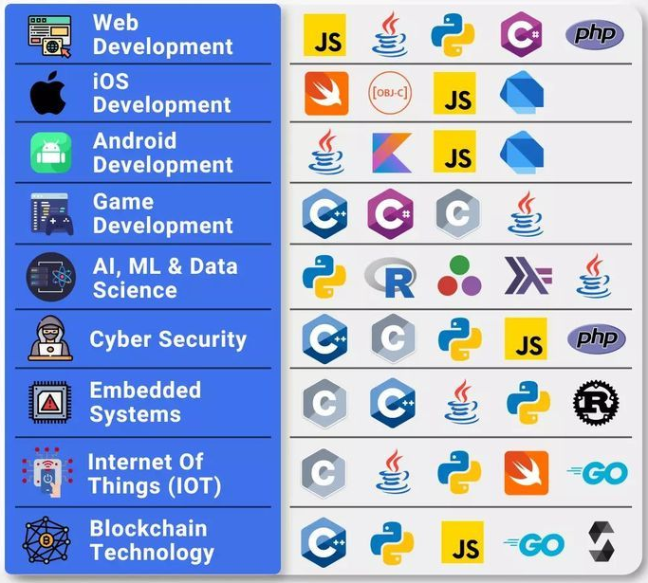
Tech Specs
Taking the developed technical specification document which describes:
Inputs, outputs, and transformations of data passing through system
Technology selections to implement and maintain
And using a coding langauges to implement it….
- python (for data related processes)

Slide 66
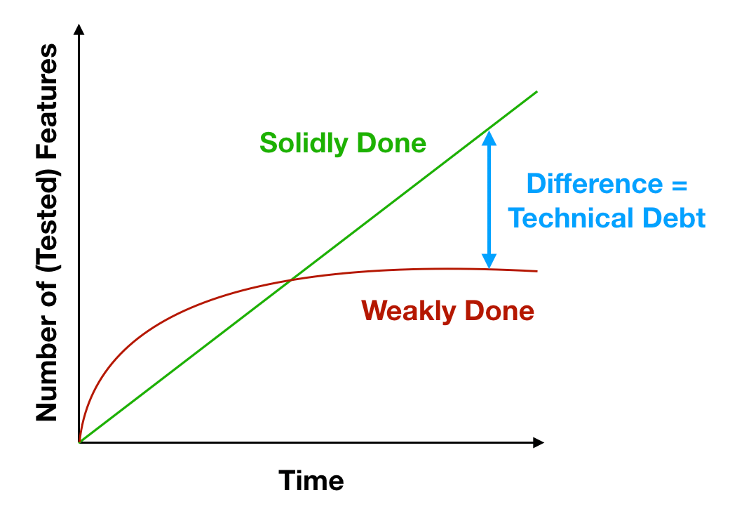
Implementation: Technical Debt
All code is technical debt
What is technical debt?
Build fast break things…
1 wk VS 1 month?
1 month VS 6 months?
Notes:
https://www.tokyodev.com/articles/all-code-is-technical-debt

Slide 67
Additional considerations for design:
Selecting a Design Approach: Build or Buy
The most common approach is to acquire a commercial system
These systems have already gone through the design and development stages
Accommodating Business Processes
Review existing processes –flowcharts
How processes SHOULD work vs OBSERVED PRACTICES
Map vendor’s system workflow diagrams to your business processes
Utilize process engineers if possible
Consider a new system’s affect on existing cost allocation methods
Supporting Business Needs
Know: What are the business needs? Where are they documented? How are they prioritized?
Map technical specifications to the business needs.
Strive to discern business needs of the future and consider them in decision processes.

Slide 68
RFI / RFP
Request for Information (RFI)
Planning document
Bi-directional exchange of information
Sample topics:
Instructions for response
Statement of scope
Functional requirements document
Business information (corporate structure, installed base, clientele)
Level of detail varies from case to case
Usually less than 10 pages
Preliminary cost estimates
Support and maintenance levels
Software release dates
Expected retirement of existing SW
Update/upgrade path options
Licensing structure
Technical specifications
Sample implementation plan
Site visit opportunities

Slide 69
RFI / RFP
Request for Proposal (RFP)
Is an invitation to present a proposal for a system that can satisfy the functional requirements and technological specifications collected during the analysis and design phases (which should match the organization’s business needs).
Requests and responses should include considerable detail including services associated with implementation, training and maintenance.
Should allow a Total Cost of Ownership (TCO) to be computed
Will transition into a contract upon vendor selection
Contains
Vendor Questionnaire
Scope
Limitations
Is a window into the culture of the customer
Is expensive for vendors and potential customers

Slide 70
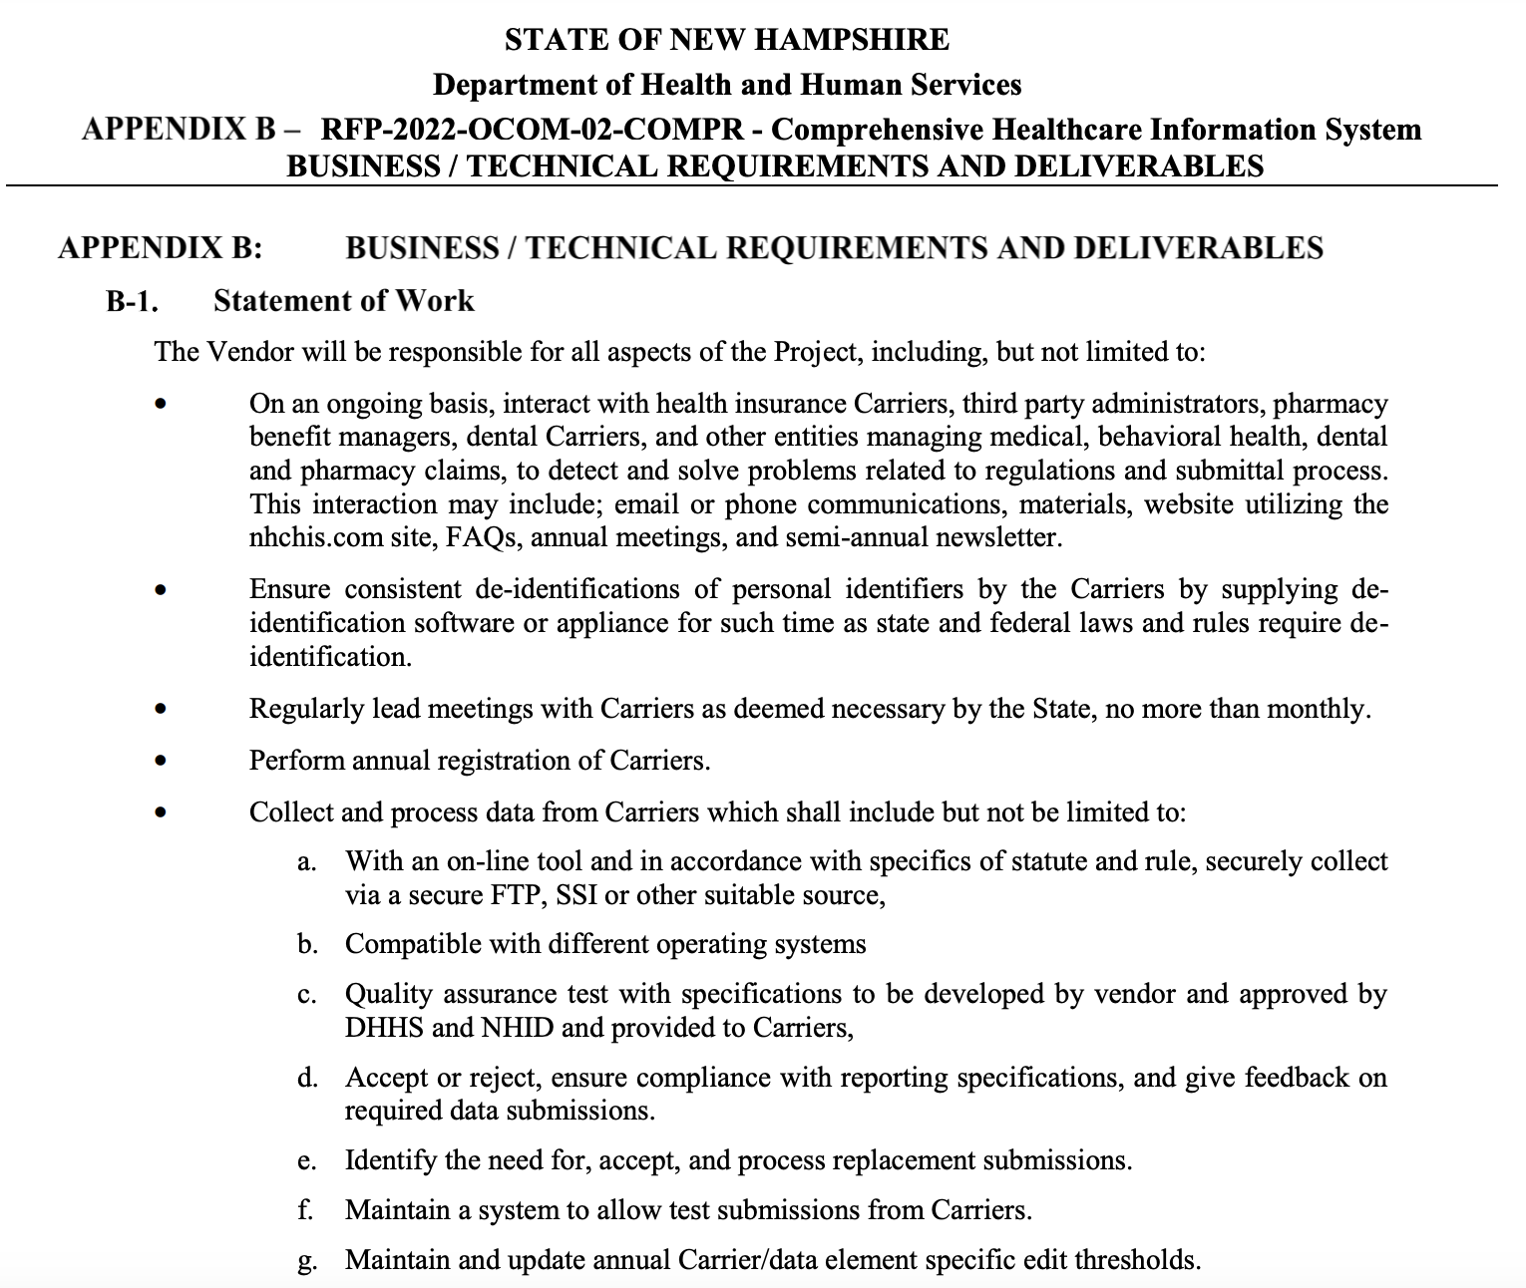
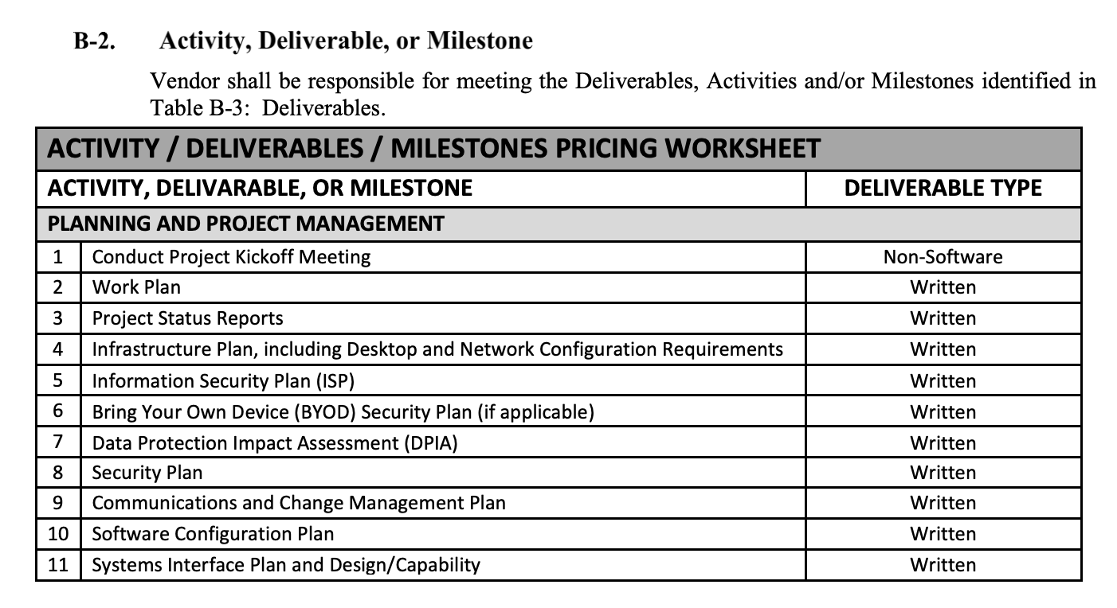
Government RFPs/RFIs: https://sam.gov/
https://www.dhhs.nh.gov/sites/g/files/ehbemt476/files/inline-documents/sonh/rfp-2022-ocom-02-compr.pdf

Slide 71
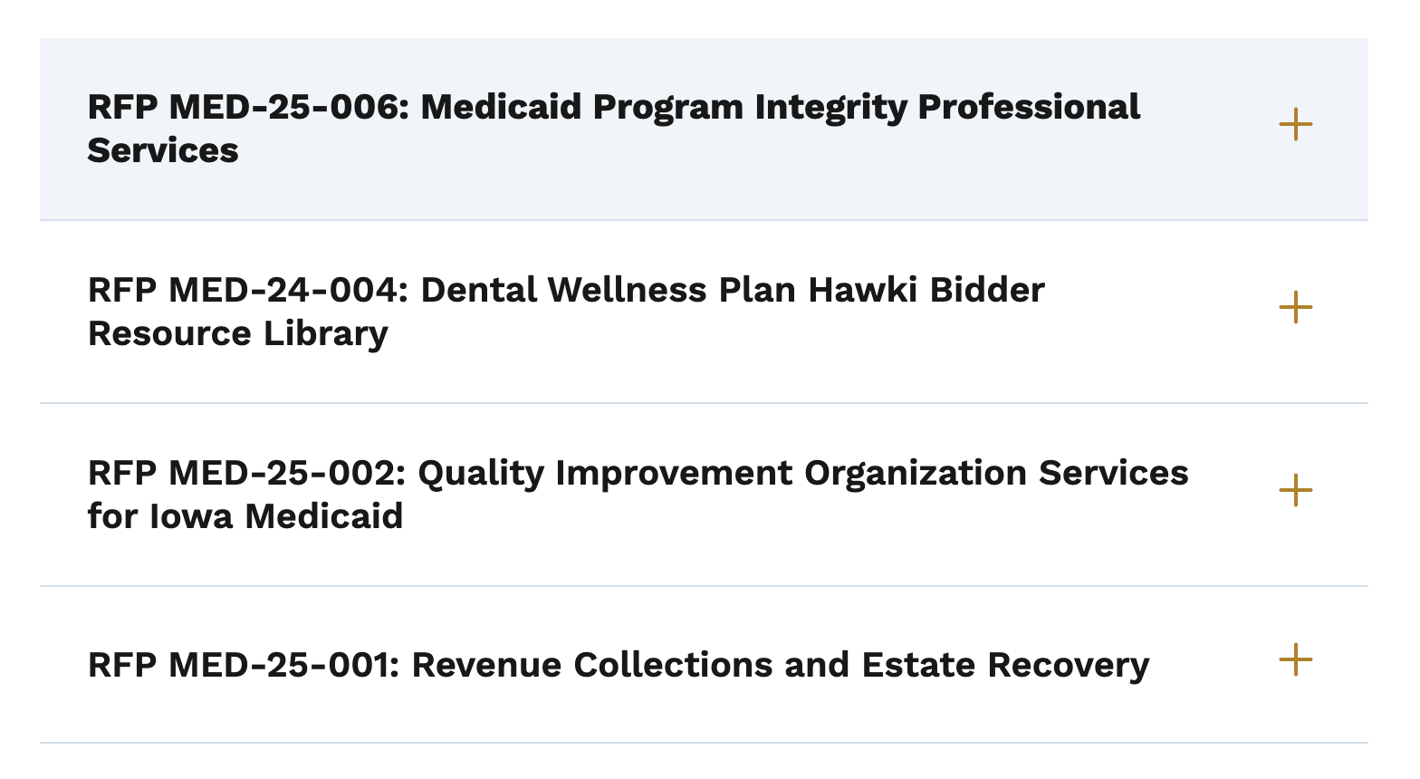
Iowa: HHS
https://hhs.iowa.gov/programs/welcome-iowa-medicaid/iowa-health-link/rfp

Slide 72
Phase 4: Implementation (PLANNING to LAUNCH)

Slide 73
Implementation
Implementation strategies:
phased rollout – new systems gradually brought ‘live’
big bang – happens all at once
parallel – new and old together
Education and training
Vendor support
Train the trainer events
Finding ‘champions’ – superusers
Conversion and “go-live”
Command centers or ‘war’ rooms

Slide 74
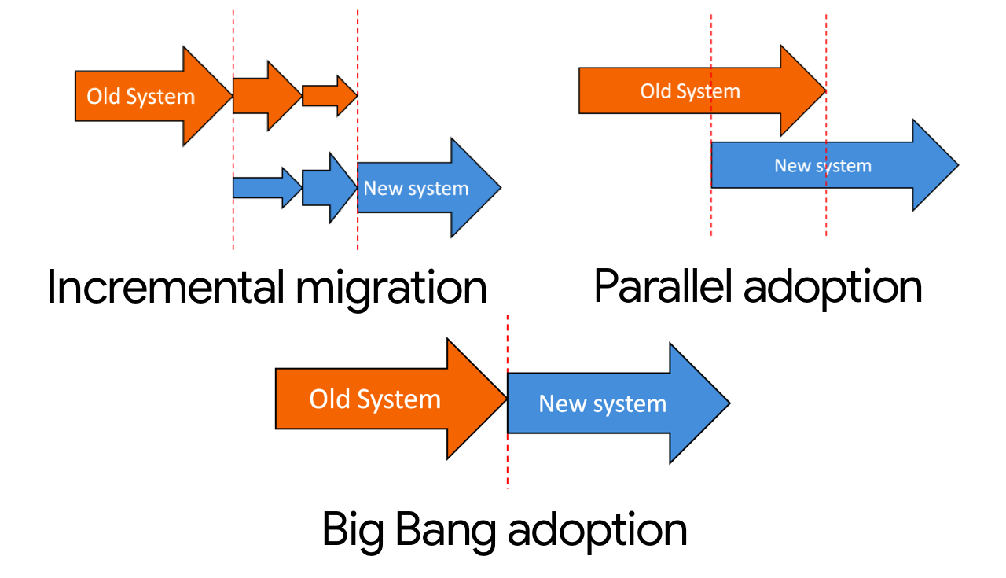
Deployment types…

Slide 75
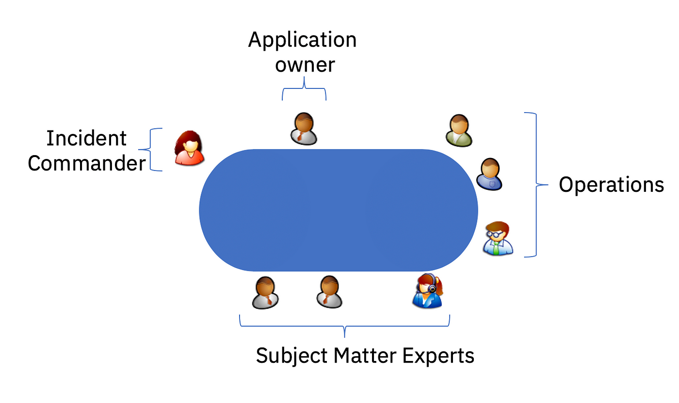

War room:

Slide 76
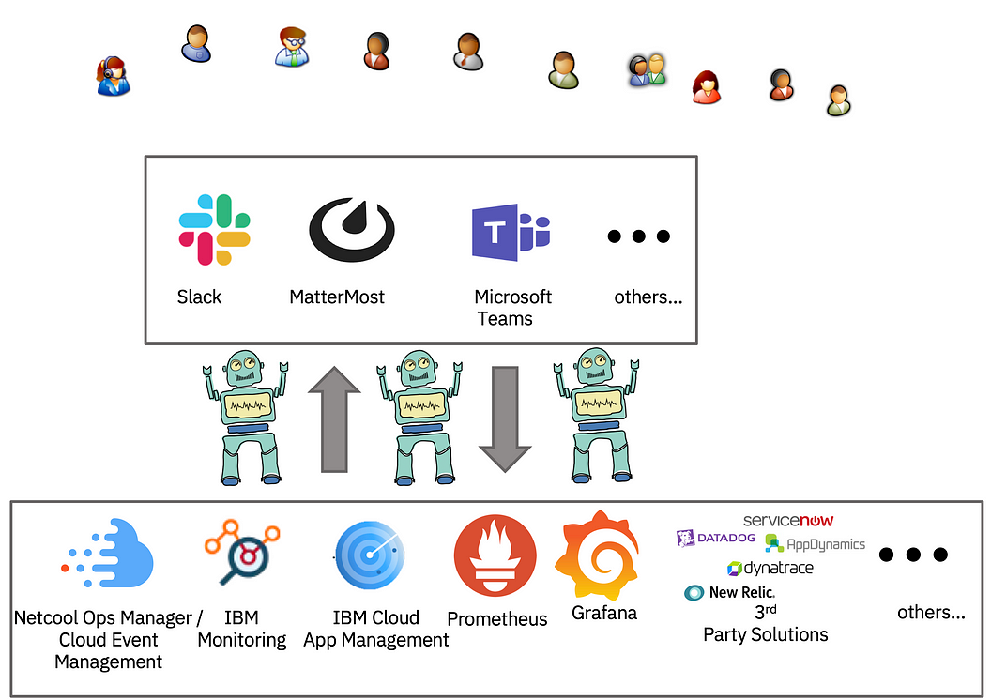
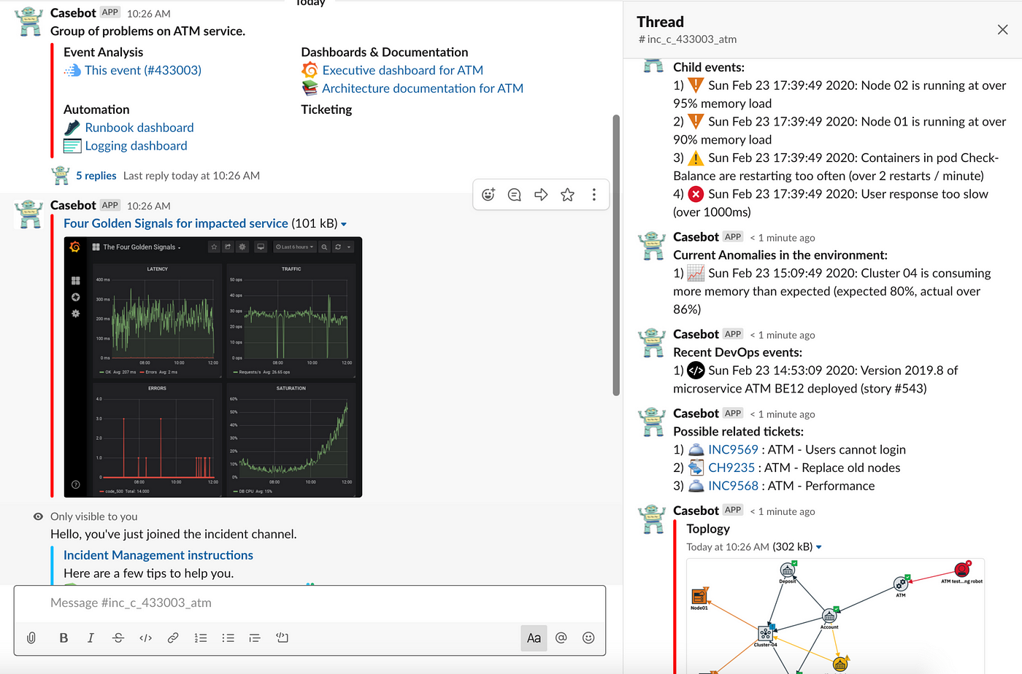
War Room Comms: Slack/Teams/etc…(chatOps)
Slack/Teams Integrations with:
- Jira (PM ticketing tool)
- Miro (white boarding)
- Alert system (
- Outlook/email automation

Slide 77
Phase 5: Testing (LAUNCH)

Slide 78
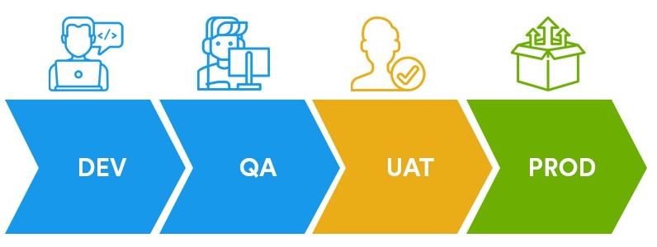
Types of testing environments…

Slide 79
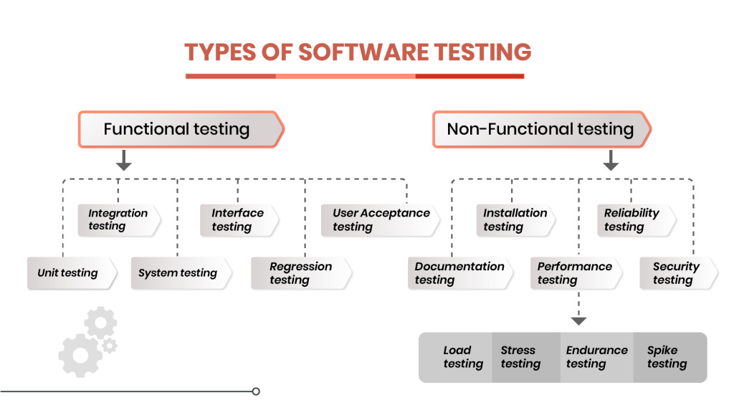
Types of tests that can be performed:
Functional: the software at a component level
Non-functional: the overall system;

Slide 80
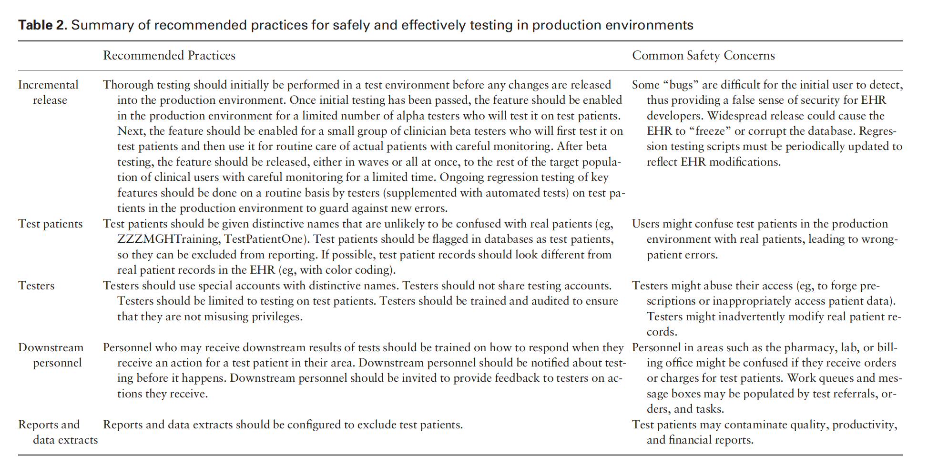

Slide 81
Phase 6: Deployment (LAUNCH)

Slide 82
Deployment types…

Slide 83
Phase 7: Maintenance and Improvements

Slide 84
SDLC Methodologies

Slide 85
SDLC methodologies (types)
Incremental/Sequential: Waterfall
Hybrid/Adaptive: Agile
Lean
Scrum, Kanban

Slide 87
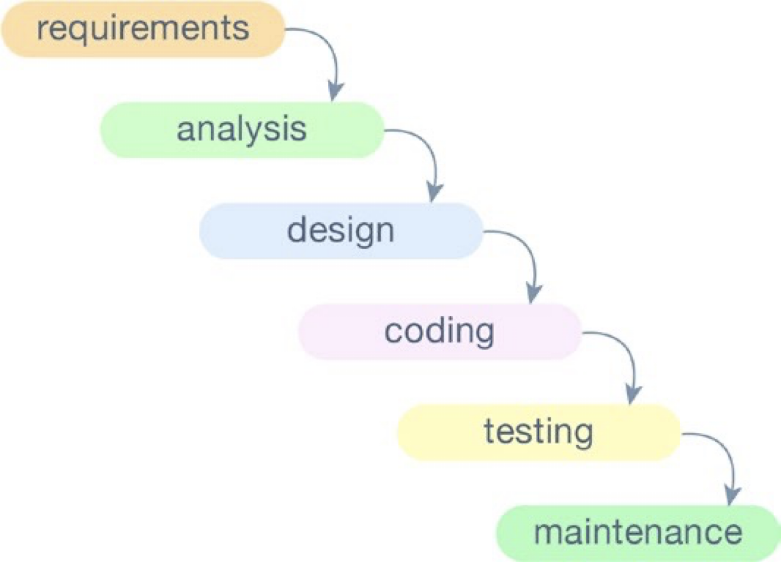
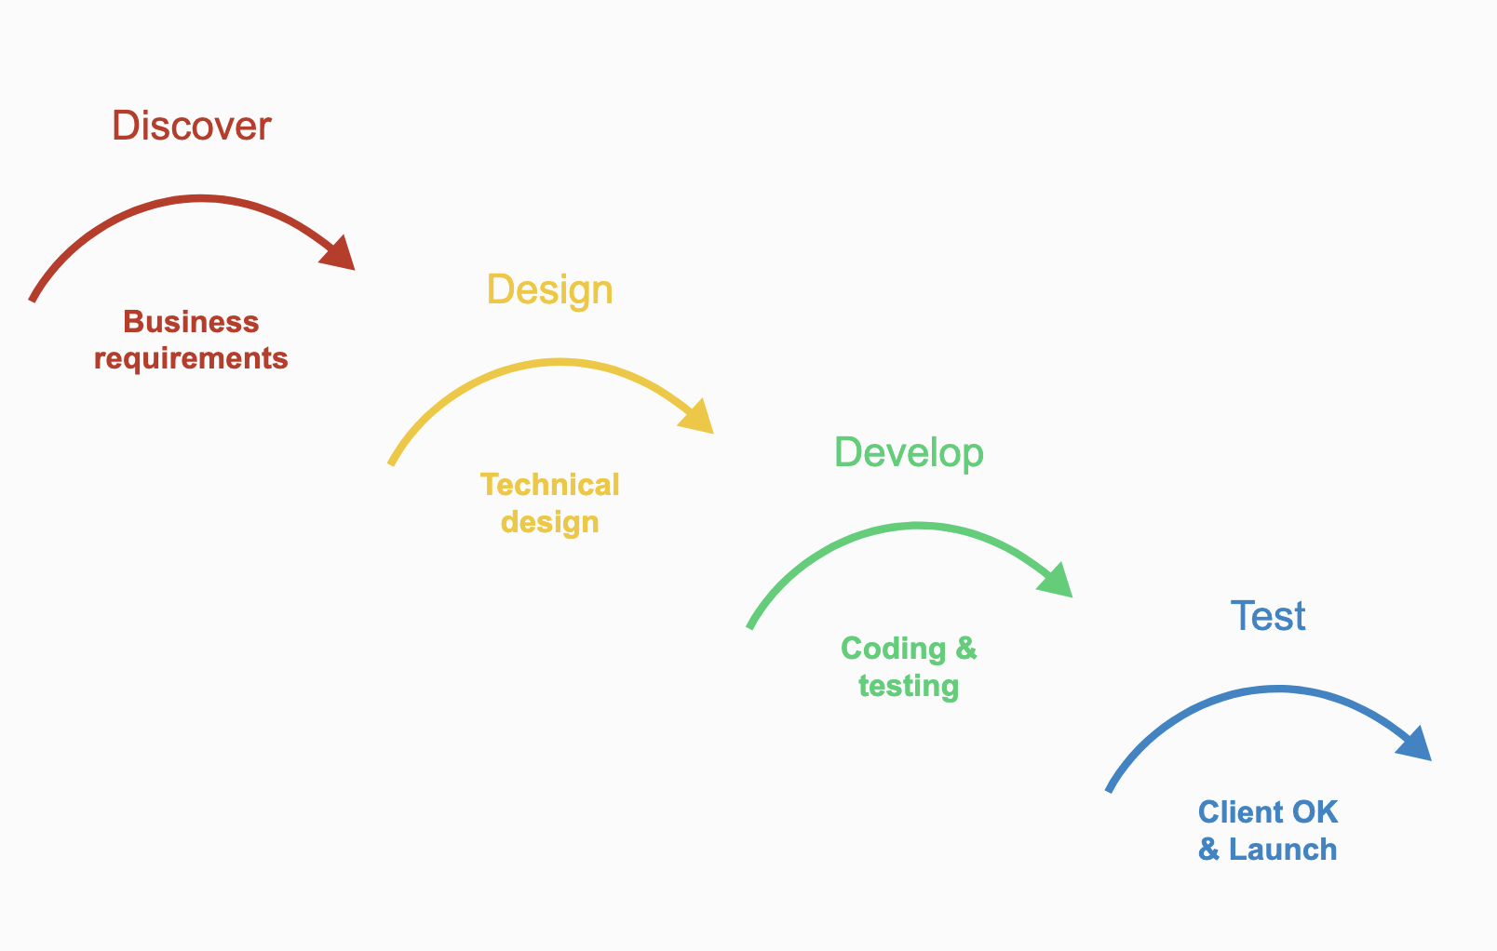
Waterfall
A project has several stages—requirements, analysis, design, coding, testing, and maintenance
Implementation is sequential
Proven very effective for small projects that are not likely to change within their time of implementation
Problem: hard to gather all the possible requirements in the beginning of a project

Slide 88
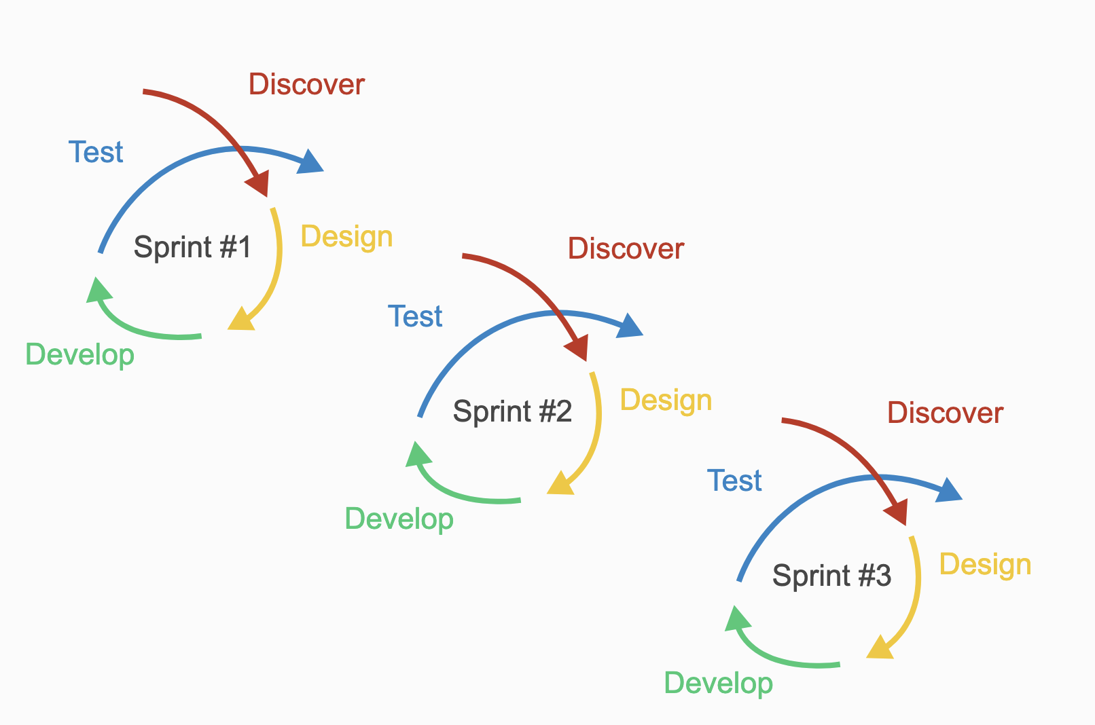
Agile
Assumption: everything always changes
Requirements are not unchangeable; they can be altered at any time
Frequent software delivery: faster we ship software to production, the faster we get feedback and the faster changes can be applied if needed
Requires CROSS-FUNCTIONAL teams {Pods}: planning, analysis, design, implementation, and quality assurance is done only the people within that team/Pod

Slide 91
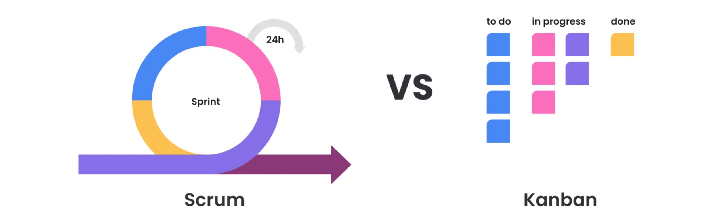

Slide 96
https://trello.com/

Slide 97
Introduction to Python

Slide 98
What can it do?
Web development
Mobile development
API creation
Data science
Database creation

Slide 99
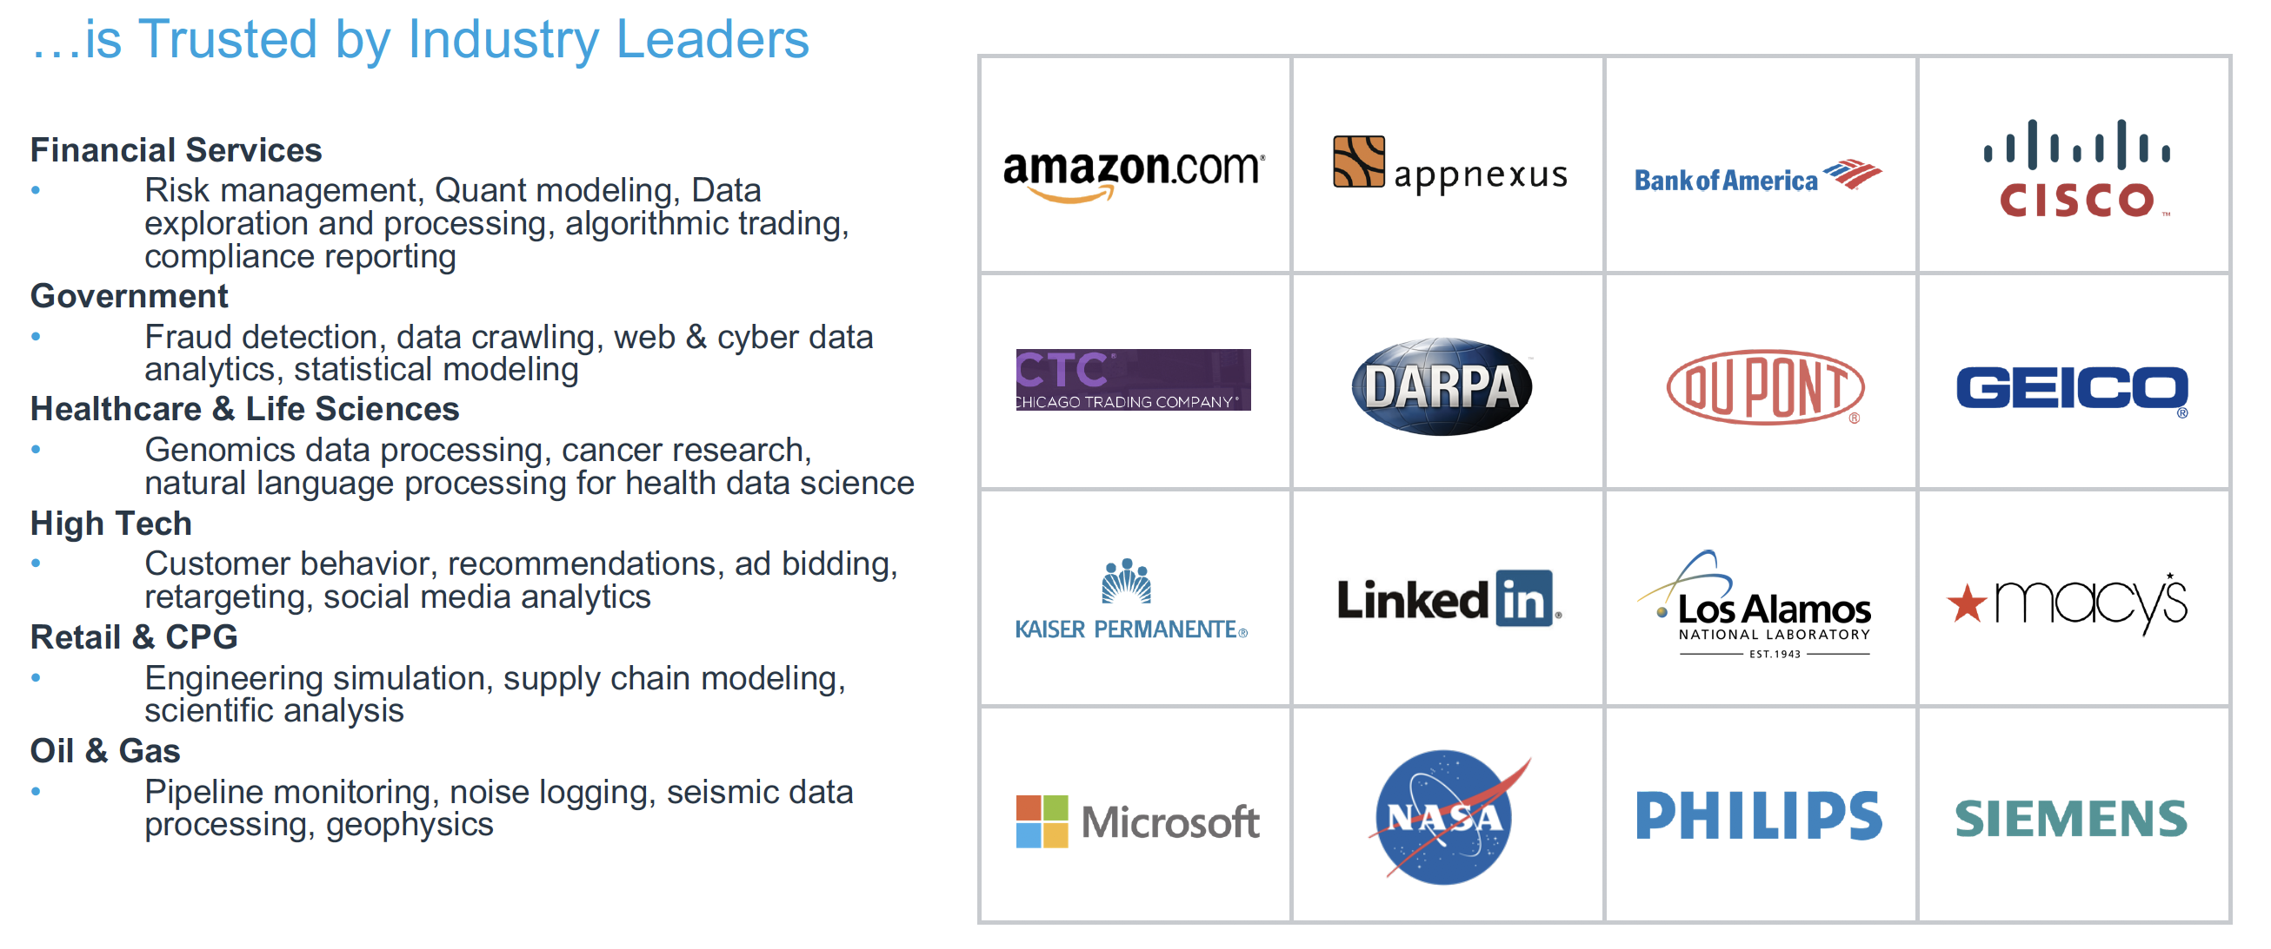
Who uses it?

Slide 100
How do we run python?

Slide 101
Local Installation
Web Browser/Cloud

Slide 102
IDE
Integrated Development Environment
Visual Studio Code
Jupyter Notebook
https://code.visualstudio.com/
https://jupyter.org/

Slide 103




Slide 104
What does it look like?

Slide 105

Notebooks:
Single document/file
Executives TOP to BOTTOM
Involves Cells
Cell Types:
Documentations (human readable)
Code
https://colab.research.google.com/notebooks/intro.ipynb
https://realpython.com/jupyter-notebook-introduction/

Slide 106
Google Colab
SPECIAL COMMANDS:
!pip install

Slide 107
Introduction to your #1 package:

Slide 108

Become a expert at reading technical documentation: it will make your life easier
https://pandas.pydata.org/docs/reference/index.html

Slide 109

https://pypi.org/

Slide 110


https://healthdata.gov

